Slide 1
1
2
3
4
5
Module 3 Healthcare services
6
The European Commission support for the production of this publication does not constitute an endorsement of the contents which reflects the views only of the authors, and the Commission cannot be held responsible for any use which may be made of the information contained therein.
Notes:
This slide should be included in every activity; but the next four slides only need to be in the introduction part of each module

Slide 2
Partners
WESTFALISCHE HOCHSCHULE GELSENKIRCHEN, BOCHOLT, RECKLINGHAUSEN
GELSENKIRCHEN, GERMANY
www.w-hs.de
PROLIPSIS
ATHENS, GREECE www.prolepsis.gr
OXFAM ITALIA INTERCULTURA
AREZZO, ITALY
www.oxfamitalia.org/
UNIVERSITAT DE VALENCIA
VALENCIA, SPAIN
www.uv.es
COORDINA ORGANIZACIÓN DE EMPRESAS Y RECURSOS HUMANOS, S.L.
VALENCIA, SPAIN
coordina-oerh.com
media k GmbH
Bad Mergentheim, GERMANY
www.media-k.eu
AKADIMAIKO DIADIKTYO (GUnet)
ATHENS, GREECE
www.gunet.gr

Slide 3
Modules
1. What is Digital Health Literacy and its relevance
2. Main health issues when landing in a new country
3. Healthcare services
4. Turning digitally literate
5. Navigating the National Health System through internet
6. Being active in the digital health environment

Slide 4
Objectives
3
Healthcare services
To improve trainees’ health literacy
To provide trainees with a first approach to navigating the national health system through the internet.

Slide 5
Competences
3
Healthcare services
Ability to understand the general functioning of the national health system and apply it in their relations with the health system.
Ability to understand and put into practice how to become a user of the national health system.
Ability to understand what the rights and obligations are, as an immigrant, in the national health system, and how to inform themselves adequately about them
Source | Pixabay license

Slide 6
3.1.1 Introduction
3.1
3.1.1
Objectives
Learn what it takes to be a beneficiary of the national health system
Learn the basic functioning of the national health system
Learn how to solve problems related to the management of one's own health
3.2
3.1.2
Let’s start …
3.1.3
3.1.4
3.1.5

Slide 7
Action 3.1.2 What do I need to be a health system user
3.1
3.1.1
Objectives
Learn the legal framework of each country regarding access to health services, focusing on the basic requirements that immigrants have to meet in order to become beneficiaries of the national health system and the basic actions they need to follow.
3.2
3.1.2
3.1.3
3.1.4
3.1.5

Slide 8
Ask yourself these questions:
3.2 What do I need to be a health system user
Do you know how the national health system works in Spain, Germany, Italy or Greece?
Have you ever had a problem or had to repeat a process, because you did not know how the national health system works here in Spain, Germany, Italy or Greece?
Source | Pixabay license

Slide 9
Videos for Spanish NHS
3.2 What do I need to be a health system user
Let’s watch the following videos and discuss!
Video 1:
https://www.youtube.com/watch?v=0olenJsacvU&ab_channel=LaPalomaHospital
Video 2:
https://www.youtube.com/watch?v=0HIMC9ITGTQ&ab_channel=CELADORESONLINETEMARIOYTEST
Source | Pixabay license
Source | Pixabay license

Slide 10
Videos for German NHS
3.2 What do I need to be a health system user
Let’s watch the following videos and discuss!
Video 1:
https://www.youtube.com/watch?v=RaSKm0o4Jc8
Video 2:
https://www.youtube.com/watch?v=sasX7aZeCGc
Source | Pixabay license
Source | Pixabay license

Slide 11
Videos for Italian NHS
3.2 What do I need to be a health system user
Let’s watch the following videos and discuss!
Video 1:
Il Servizio Sanitario Nazionale - YouTube
Video 2:
The Health Care System in Tuscany - YouTube
Source | Pixabay license
Source | Pixabay license

Slide 12
Videos for Greek NHS
3.2 What do I need to be a health system user
Let’s watch the following videos and discuss!
Video 1:
https://www.youtube.com/watch?v=F62d6kCPGzE
Video 2:
https://www.youtube.com/watch?v=p3LQlz0ZZKg&t=4s
Source | Pixabay license
Source | Pixabay license

Slide 13
Actions 3.1.3 & 3.1.4 What would you do?
3.1
3.1.1
Objectives
You will work as a group and discuss how to resolve issues based on scenarios.
You will learn how to cope with different situations.
3.2
3.1.2
3.1.3
3.1.4
3.1.5
Source | Pixabay license

Slide 14
What would you do? - STEPS
3.3 What would you do?
The activity is composed of 8 scenarios
Trainees split in 4 groups: the first 4 scenarios are distributed among the groups by means of cards.
The groups discuss the scenarios given to them
Time is allowed so that each group explain to the others which scenario they have received and how they would solve them.
A short discussion between all the trainees is encouraged.
The trainer explains the basic functioning of the health system in the area under discussion.
The process is repeated with the following 4 scenarios.
Source | Pixabay license

Slide 15
Topic 1 - Emergency
3.3 What would you do?
There is a person running along the river at 8 am. The ground is wet from the previous night's rain. The person is running cautiously but in order to avoid a stone he steps in a hole that was not visible because it was waterlogged. As he puts his foot in the hole, his foot buckles and he falls to the ground. He starts shouting "help!" repeatedly and finally you, who were just passing by, hear him.
How would you act in this situation?
Source | Pixabay license

Slide 16
Topic 2 - Admission
3.3 What would you do?
You have an appointment for surgery with the surgeon Dr. Perez at 08:00. When you arrive at the hospital you don't know where to go. What should you do?
Go to the Information Desk
Go to the operating theatre floor and ask for Dr. Pérez.
Go to Admission
Explain why.
Source | Pixabay license

Slide 17
Topic 3 - Family Doctor
3.3 What would you do?
The cold of the last few days makes you sneeze, cough, have a sore throat and a stuffy nose. You would like to take a pill for the pain but you don't know which one. What should you do?
Explain the steps you should take.
Source | Pixabay license

Slide 18
Topic 4 - Hospital/Specialist
3.3 What would you do?
Following a fall you had while cycling, your GP has told you that he is referring you to a specialist for specific tests and further treatment. He does not give you an appointment immediately but tells you that a letter with the appointment will be sent to your home.
Explain which specialist you will be seeing and why.
Explain where you will need to go to be seen by the specialist.
Source, Pixabay license

Slide 19
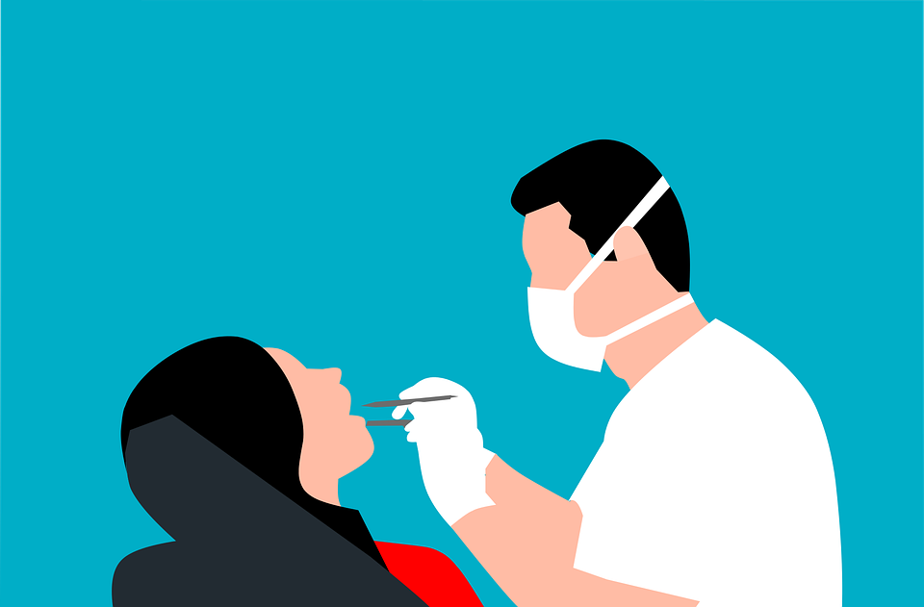
Topic 5 - Dental Services
3.3 What would you do?
You woke up with a slightly swollen mouth and you complain about the pain in one of your molars. You have been taking painkillers for several days but the discomfort continues.
Explain where you should go first to be treated and why.
Source, Pixabay license

Slide 20
Topic 6 - Psychologist
3.3 What would you do?
Alberto's mother died a few weeks ago and since then he has not been able to get out of bed. He feels sad and his condition is affecting his performance at work. A friend has told him that he should see a psychologist to help him deal emotionally with his grief.
What steps should Alberto take to be seen by the specialist?
Source | Pixabay license

Slide 21
Topic 7 - Pharmacy
3.3 What would you do?
I went to the pharmacy to buy a cough syrup and a muscle relaxant to help me rest better at night. When I gave her my SIP card, the pharmacist told me that she could sell me a type of natural cough syrup, but not the tablets, as she said I needed a prescription to buy them.
What are the health steps you have to follow to be able to have a prescription prescribed by a doctor?
Why have they only been able to sell you a natural syrup and not another type?
Do you need to show your health card to buy over-the-counter medicines?
Source | Pixabay license

Slide 22
Topic 8 - Vaccination
3.3 What would you do?
When travelling abroad by air, airlines are asking for security documents to be attached to COVID 19. What are these documents and what information is reflected?
Source | Pixabay license

Slide 23
ONLINE MAP
3.3 What would you do?
SPAIN: Download the map of the Spanish Health System from here!
GERMANY: Download the map of the German Health System from here!
ITALY: Download the map of the German Health System from here!
GREECE: Download the map of the German Health System from here!

Slide 24
Action 3.1.5 Closing - debriefing
3.1
3.1.1
Objectives
You will be provided with a summary and clarifications on possible doubts and questions.
3.2
3.1.2
3.1.3
3.1.4
3.1.5

Slide 25
Summary
Clarifications

Slide 26
Action 3.2.1 Excursion/practical visit
3.1
3.2.1
Objectives
You will learn how the national health system works and, in particular, on the rights and obligations that participants have as immigrants and as general users of the system.
3.2
3.2.2

Slide 27
POOLING OF THE HOMEWORK: PRACTICAL VISIT
Practical Visit
Is there anything you did not know before the visit that you know now thanks to it?
What did you find the most important in terms of managing your own health
How is a health centre organised?
What can you do/ask for in a health centre?
Source | Pixabay license

Slide 28
Action 3.2.2 Closing - debriefing
3.1
3.2.1
Objectives
You will be provided with a summary and clarifications on possible doubts and questions.
3.2
3.2.2

Slide 29
Summary
Clarifications

Slide 30
Congratulations! You have completed this module!
The European Commission support for the production of this publication does not constitute an endorsement of the contents which reflects the views only of the authors, and the Commission cannot be held responsible for any use which may be made of the information contained therein.

