Slide 1
1
2
3
4
5
Module 4 Turning Digitally Literate
6
The European Commission support for the production of this publication does not constitute an endorsement of the contents which reflects the views only of the authors, and the Commission cannot be held responsible for any use which may be made of the information contained therein.

Slide 2
Partners
WESTFALISCHE HOCHSCHULE GELSENKIRCHEN, BOCHOLT, RECKLINGHAUSEN
GELSENKIRCHEN, GERMANY
www.w-hs.de
PROLIPSIS
ATHENS, GREECE www.prolepsis.gr
OXFAM ITALIA INTERCULTURA
AREZZO, ITALY
www.oxfamitalia.org/
UNIVERSITAT DE VALENCIA
VALENCIA, SPAIN
www.uv.es
COORDINA ORGANIZACIÓN DE EMPRESAS Y RECURSOS HUMANOS, S.L.
VALENCIA, SPAIN
coordina-oerh.com
media k GmbH
Bad Mergentheim, GERMANY
www.media-k.eu
AKADIMAIKO DIADIKTYO (GUnet)
ATHENS, GREECE
www.gunet.gr

Slide 3
Modules
1. What is Digital Health Literacy and its relevance
2. Main health issues when landing in a new country
3. National Health Systems
4. Turning digitally literate
5. Navigating the National Health System through internet
6. Being active in the digital health environment

Slide 4
Objectives
4
Turning digitally literate
To improve operational skills for being digital active

Slide 5
Competences
4
Turning digitally literate
Knowledge about the differences between Computer, Smartphone and Tablet and the different use of it
Ability to navigate and search information on the internet
Knowledge about data protection and security on the internet
Knowledge about communication channels on the internet
Source | Pixabay license

Slide 6
Action 4.1.1 Introduction
4.1
4.1.1
Objectives
4.2
4.1.2
You will learn about Digital Health Literacy and how to be active in the digital environment, especially by considering the use of different digital devices and additional skills such as the evaluation of digital informatiοn.
Let’s start …
4.1.3

Slide 7
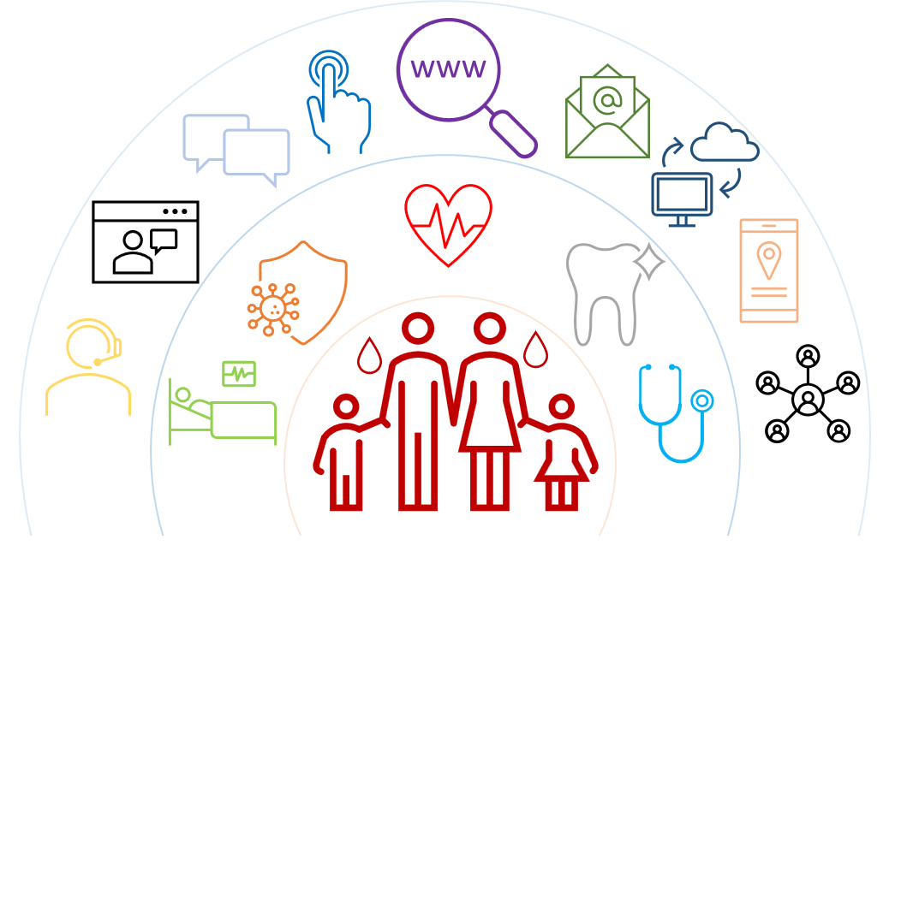
What is Digital Health Literacy
4.1 Introduction
Digital Health Literacy (DHL) is defined as
the ability to seek, find, understand, and appraise health information from electronic sources, and
apply the knowledge gained to addressing or solving a health problem (WHO Digital Health Literacy, 2017).

Slide 8
What is Digital Health Literacy
4.1 Introduction
Digital Health Literacy covers five different dimensions:
Information and data literacy
Communication and collaboration
Digital content creation
Safety
Problem solving
More information: [1]

Slide 9
Operational skills for DHL
In this module, we focus on operational skills, and especially:
how to use a digital device,
what digital devices are available,
where to find information on the internet, and
what rules needed to be considered while acting in the digital environment.
BUT Digital Literacy is more than using digital devices:
it is also important to evaluate and critically question digital information!

Slide 10
Action 4.1.2 Practical activity: Getting to know different digital devices
4.1
4.1.1
Objectives
4.2
4.1.2
You will learn about the different digital devices you can use for searching for information on the internet.
4.1.3
Source | Pixabay license

Slide 11
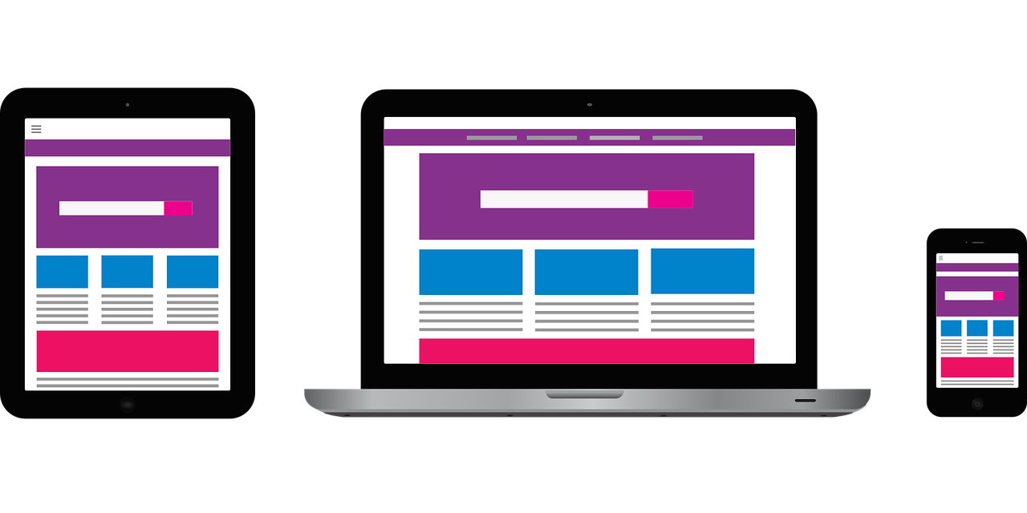
Digital Devices
4.2 Getting to know different digital devices
To be active in the digital environment, a digital device is necessary.
There are different digital devices available.
Each device has its advantages and disadvantages.
Therefore, we are going to discuss, what device is useful for what specific activity.
Source | Pixabay license
Notes:
*short introduction to DL🡪 it´s not static, everyone has to trains the DL; the technology is developing all the time

Slide 12
Digital Devices
4.2 Getting to know different digital devices
What different digital devices do you know and which ones are you using?
To begin with the discussion, please tell what digital devices you know, and you are using.
In the next step, we want to create some profiles for each device, to clarify for what activity each device is useful.
Click here to check your list !
Start a list:
…..
……
……
List of digital devices
Computer
Laptop
Tablet
Smartphone

Slide 13
Profile of digital devices (1/3)
4.2 Getting to know different digital devices
1. Computer/Laptop
Description: A computer is an electronic device used for a variety of purposes, e.g., browsing the web, writing documents, playing video games, etc.
Useful for: Complex internet research, writing long texts, writing e-mails.
Not useful for: Doing some internet research or writing small texts while you are on the way.
Source | Pixabay license

Slide 14
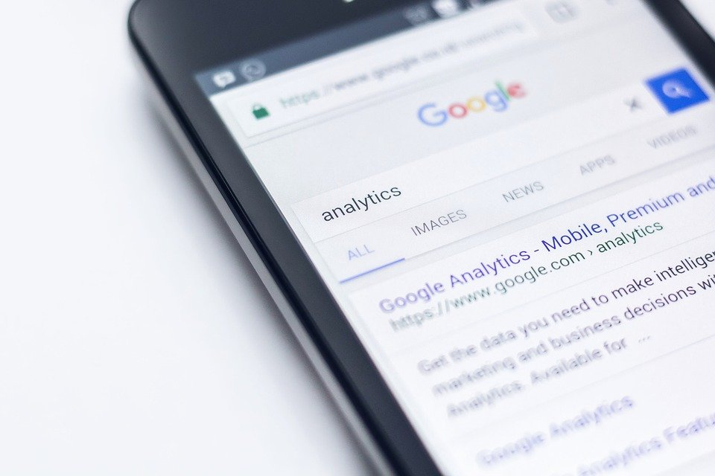
Profile of digital devices (2/3)
4.2 Getting to know different digital devices
2. Smartphone
Description: A smartphone is a mobile phone with which it is possible to do a lot more things than just make phone calls. For example, smartphones can connect with the internet, and can take photos or videos. Therefore, it can also be seen as a small computer. The screen of a smartphone is a touchscreen.
Useful for: Writing short messages, doing small internet research, using social media, such as WhatsApp, Instagram, etc.
Not useful for: Writing long texts or doing long internet research.
Source | Pixabay license

Slide 15
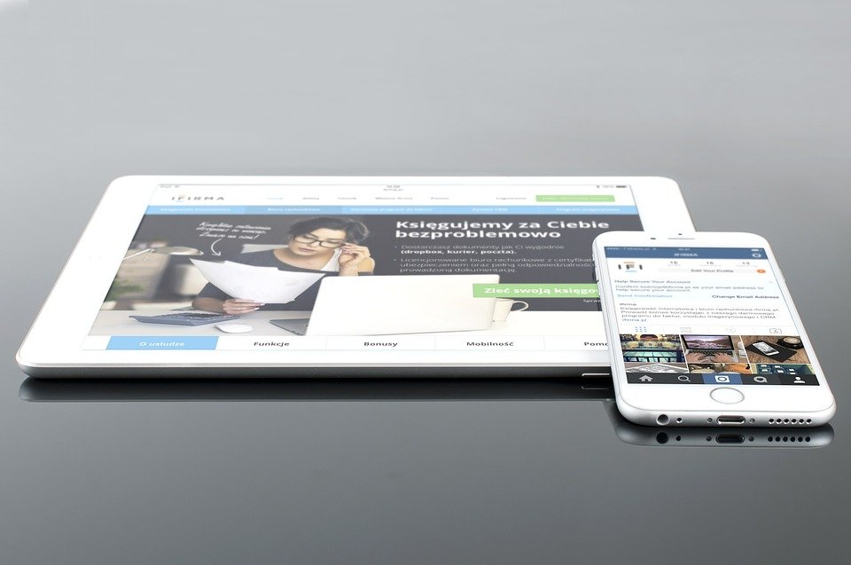
Profile of digital devices (3/3)
4.2 Getting to know different digital devices
3. Tablet
Description: A tablet is smaller than a computer or laptop but taller than a smartphone. It has a touchscreen but, different from a laptop, no keyboard.
Useful for: Small research activities, downloading and reading books, playing games, watching videos, checking mails
Not useful for: Writing long e-mails or other texts, long research activities.
Source | Pixabay license

Slide 16
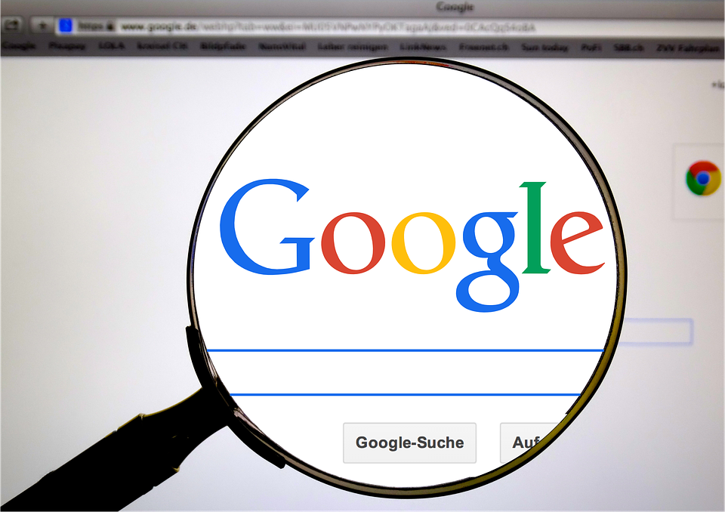
Action 4.1.3 Searching on the internet
4.1
4.1.1
Objectives
4.2
4.1.2
The next part is about getting the first insight about how to search for information on the internet.
4.1.3
Source | Pixabay license

Slide 17
Introduction
4.3 Searching on the internet
Click here for some information !
One activity, which is possible with all the devices, is searching for information on the internet. But related to the research you want to conduct, the devices are suitable in different ways.
Once you have decided which device you want to use, there are some different steps you should consider, during the research.
A description of these steps is followed in the next slides. → Please see annex 1 to find an explanation of the World Wide Web.
www
Well, the correct phrase is „searching information on the World Wide Web“, instead of internet. See next slide.

Slide 18
Web-browsers
4.3 Searching on the internet
For searching for information on the Web, you need to open a web browser (step 1). Usually, a web browser is already available on your device.
Some of the most common web-browsers:
Google Chrome
Mozilla Firefox
Microsoft Edge
Apple Safari
Opera

Slide 19
Websites (1)
4.3 Searching on the internet
As mentioned earlier, the websites contain the information. So, the next step (step 2) is to connect to the proper website which contains the information you are looking for.
For connecting to a website, you have to know its domain name, e.g., healthcare.eu.
So, the next questions are:
“Which website(s) should I visit to find the information I am looking for?”, and
“How can I find the domain name of this/these website(s)?”

Slide 20
Websites (2)
4.3 Searching on the internet
For the first time, we have been somehow informed about the domain name, e.g.,
read it somewhere,
advised from someone,
found it in another website with related content, or
used a search engine to find the domain names of the website
Concluding,
if you already know the domain name,
you may enter it directly into the browser and connect to the website
otherwise,
use a search engine to find it out
A search engine is a service for finding websites. It collects available websites on the Web and associates them with several tags, which are keywords related to the website's main information category.
The user connects via a browser to the search engine.
Enters the keywords
The search engine returns a list of websites related to the keywords
The user chooses to visit one or more websites
Click here for more information about the search engines

Slide 21
Search engines
4.3 Searching on the internet
yahoo.com
For searching information on the internet, you have to connect, with your web browser, to one of the available search engines.
Some of the most popular search engines are the following:
Google.com: You can differentiate your research via google between information, photos or you can use it for navigation.
Bing.com: The structure and function are usually similar to Google, but the search results could be different.
Yahoo.com: Quite similar to Bing.
google.com

Slide 22
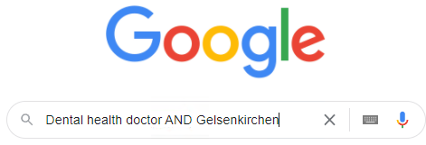
Activity: Search strings
4.3 Searching on the internet
Activity
Example: Where is the next doctor for dental health?
“Dental health doctor AND Gelsenkirchen“
Please discuss, which of the following search strings are the best ones:
Information of interest: Do I have to pay for my dental treatment myself as an asylum seeker in Germany?
Do I have to pay for my dental treatment myself?
Payment for dental treatment AND Asylum seeker AND Germany
Payment for dental treatment

Slide 23
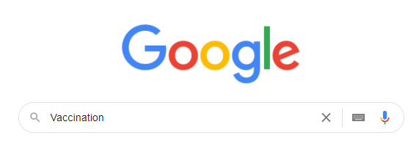
Activity: Search strings
4.3 Searching on the internet
Activity
Discuss, which of the following search strings are the best ones:
Information of interest: Should I get vaccinated against COVID-19?
Advantages AND Vaccination AND COVID-19
Should I get vaccinated against COVID-19?
Vaccination

Slide 24
Alternative ways of searching information on Web
4.3 Searching on the internet
There are also alternatives in finding information about a topic:
Thematic web directories. They are organized lists that contain websites, even commercial ones, which focus on a specific topic, e.g., health.
Forum. A forum is another way of communication in the digital environment which allows interaction with other internet users over a specific topic. You may register and join a forum for
asking specific questions and receiving replies, or
looking for replies to similar questions like your question(s)
Example: https://www.healthboards.com/
You may use search engines to find web directories and forums, e.g., by using the keywords
“Forum AND health”
Forum

Slide 25
Activity: Search a forum or Web directory
4.3 Searching on the internet
Activity
Example 1: Where can I find a forum for finding a dentist in Madrid?
“Forum AND Dentist AND Madrid“
Example 2: Where can I find a Web Directory for dentists in Madrid?
“Web AND directory AND Dentist AND Madrid“
Please discuss, which of the results search strings are the best ones.

Slide 26
Find information
4.3 Searching on the internet
How can I find the information I´m interested in?
Aspects to be considered while creating a search string:
Focus on relevant keywords, especially nouns.
Specific use of search operators:
AND: Linking two or more search terms.
OR: The search results contain one or the other or all of the search terms.
Brackets: Brackets can be used to compose requests with the above-mentioned search operators.
More information: [2]

Slide 27
What operators can be used to build a search string?
Only one answer is correct!
A. No specific operators
B. AND + OR + Brackets
C. AND + Brackets
D. AND + OR

Slide 28
Action 4.2.1 Security and Privacy
Competencies about security and privacy refer to the ability to protect devices, content, personal data, and privacy in the digital environment.
4.1
4.2.1
4.2
4.2.2
4.2.3
More information: [2]
Source | Pixabay license

Slide 29
What is Personal Data
Examples of personal data
a name and surname
a home address
an email address such as
name.surname@company.com
an identification card number
location data, for example the location data function on a cell phone)
an Internet Protocol (IP) address
a cookie ID
the advertising identifier of your phone
data held by a hospital or doctor, which could be a symbol that uniquely identifies a person.
Personal data is any information that relates to an identified or identifiable living individual.
Different pieces of information, which are collected together can lead to the identification of a particular person, also constitute personal data.
Can you provide some examples of Personal Data?
Click here for examples !
Source | Pixabay license
More information: [3]

Slide 30
What personal data is considered sensitive?
The following personal data is considered ‘sensitive’ and is subject to specific processing conditions:
personal data revealing racial or ethnic origin, political opinions, religious or philosophical beliefs
photos, videos
trade-union membership
genetic data, biometric data processed solely to identify a human being
health-related data
data concerning a person’s sex life or sexual orientation
Source | Pixabay license

Slide 31
Is there personal data that is considered particularly sensitive?
Yes
No

Slide 32
What is Security
4.4 Security and Privacy
Security is about how to secure, protect your personal data from unauthorized access either to your device or the remote web server or during communication over the internet.
We use security controls at the technical level to restrict who can access the information. These controls are applied
to our devices (PC, tablet, mobile phone), i.e., apply updates of the operating system and software, use strong passwords
to the remote web server, i.e., use strong passwords
during data transmission over the Internet, i.e., use the secure protocol https
Source | Pixabay license

Slide 33
Is the website secure?
4.4 Security and Privacy
For protecting personal data it is important to assess if the website is secure.
Secure in this context means that
all technical security criteria are met, and
we can ensure that the website is original and not a fake one.
What criteria need to be considered for deciding if a webpage is safe?

Slide 34
Is the website secure?
4.4 Security and Privacy
What criteria need to be considered for deciding if a webpage is secure?
Start a list:
……………..
……………..
……………..
Click here to check your list !
Are the technical requirements completed? e.g., “https” at the beginning of the link.
Is the website displayed correctly in the browser and does it work in all sections?
More Information: [4]

Slide 35
Is the website secure?
4.4 Security and Privacy
A secure website has a link in which
the https protocol is used, s means secure
An original website, e.g., a website of a bank, has a link in which
the domain name includes its official name, or it is close to it
it is relatively short
Click here for more information about the https protocol
Hypertext Transfer Protocol Secure (HTTPS) is an extension of the Hypertext Transfer Protocol (HTTP). It is used for secure communication over a computer network and is widely used on the Internet.
The https protocol ensures that
the data are encrypted during the transmission over the Internet, and nobody can read them (encryption)
the receiver is indeed the receiver and not someone who pretends (authentication)
For more information visit https://en.wikipedia.org/wiki/HTTPS

Slide 36
How to check if https is used
4.4 Security and Privacy
The https is included in the link.
When a browser is connected to a secure website, a lock symbol appears next to the link.
This symbol indicates that the website is secure.

Slide 37
Non secured websites or links
4.4 Security and Privacy
The http is included in the link.
When a browser is connected to a not secure website,
a “lock with a red line” symbol, or
a triangle with the attention mark
“Not secure” message
appears next to the link.
These symbols and messages indicate that the website or link is not secure.
!

Slide 38
Is a link safe to visit?
4.4 Security and Privacy
If https is used in a link but the domain name is not close to the official name, then
the website could be a fake clone of the original with the purpose to steal your personal data.
If http is used in a link, instead of https, but the domain name is fine, then
the transmission of the personal data over the Internet is not secured, so you should not use this website for submitting any personal data.
Source | Pixabay license

Slide 39
Is the link safe to visit?
4.4 Security and Privacy
If you receive an email, e.g., by a bank, which urges you to press a link like the following, and submit personal data, such as username, passwords, credit card details, pause and think twice!
http://url5423.eka.de/ls/click?upn=V1OaWNMSPs2Lb0JqHpnyTLRlk2703ToIFpo2vd2MKt5gB6dYAUvw1B-2FnC6T5iVsCdbcug7l6pkTad-2FBfACSlC-2BKw-3D-3DhmuAs-OaWNMSPs2Lb0JqHpn-asDvdva
This link is not secure for many reasons:
it uses http instead of https
the domain name is not related to the official bank name
the link is suspicious long
the domain name of the link is different from the domain name of the senders’ email address
a real bank will never ask you username, passwords, credit card details
→ Please see annex 2 for more tips for protecting data and devices

Slide 40
Is a website always safe to use if “https” is used in the link?
Yes
No

Slide 41
What is Privacy?
4.4 Security and Privacy
Privacy is about
how to control our personal data and
determine how they are used by the remote parties who have received it, in a securely.
Recall the privacy policies you’re asked to read and agree to when you access a website or you download a new smartphone app.
→ Please see annex 3 for a differentiation on Security and Privacy
Source | Pixabay license

Slide 42
Privacy policy
Is there any policy that the website follows regarding our personal data, that is how the website uses our personal data?
This policy is called the privacy policy and should be available and easily accessible to us on the website, so we can read it and know how our data are used.
Actions:
Check and read the Privacy Policy before submitting any personal data.
Check who is the owner of/responsible for the website? Check and read the „imprint“ section.
Check for contact details.
Check for the Terms of Use and Legal Notice
Check for request consent cookies.
→ Please see annex 4 for more information
Source | Pixabay license

Slide 43
Is the website trustable?
4.4 Security and Privacy
For protecting personal data and privacy it is important to assess if the webpage is trustable.
Trustability in this context means that the website uses and processes our personal data according to the available privacy policy and regulations.
For developing a list of criteria to decide if a webpage is trustable, please start the following discussion (you can collect the results on the next slide):
What criteria need to be considered for deciding if a webpage is trustable?

Slide 44
Is the website trustable?
4.4 Security and Privacy
Activity
What criteria need to be considered for deciding if a website is trustable?
Start a list:
…..
……
……
Click here to check your list !
Who is responsible for the website? Background of the website (e.g., is the site privately or publicly run?). Is available the “imprint”?
How can we contact the website? Are adequate contact details and a communication section on the website?
Is available the Privacy Policy, Legal Notice, Terms of Use?
Is available any request consent cookies.

Slide 45
Is the website reliable?
4.4 Security and Privacy
Reliability in this context means that the content and the information available on the website is valid and we can be based on it
Questions:
A website could be secure and safe to visit as well as trustable to provide personal data, but is it also reliable regarding the content?
Can we consider reliable the content by default all the websites that are safe and trustable?
Is the content valid?

Slide 46
Is the website reliable?
4.4 Security and Privacy
Activity
What criteria need to be considered for deciding if a website is reliable?
Click here to check your list !
Start a list:
………………
………………
………………
………………..
Fulfill the criteria for a safe and trustable website.
Are the objectives of the website available?
Follow a professional design?
The content is of high quality.
No grammar and spelling mistakes
Is the content up to date?
Are the statements supported by reference to sources?
Are there links to this website from other valid/reliable websites.
Tip: The best way to look for information is on official sites, especially those of government-related organisations.
More information: [4]
Source | Pixabay license

Slide 47
Example- Secure, trustable, and reliable website
4.4 Security and Privacy
Activity
Check the website
https in the beginning of the link
Contact details are easy to find
It is clearly recognisable who is responsible for the website
Data Protection is listed
imprint/legal notice is existing
Copyright sign is used
More information: [5]

Slide 48
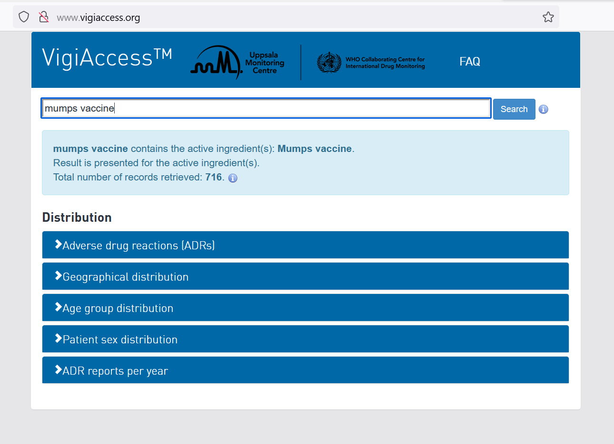
Example- Website is not secure, trustable or reliable
4.4 Security and Privacy
Activity
Check the website
No https in the beginning of the link
Contact details are missing
Data Protection is missing
imprint/legal notice is missing
More information: [6].

Slide 49
Group Dynamic Activity: Case studies- Is the website safe and the content trustable?
4.4 Security and Privacy
Activity
You can find some different kinds of websites below, all dealing with the question „Should I get vaccinated against COVID-19?“. Please decide in groups of 3-5 persons if the website is safe and trustable. You can use the list of criteria to justify your decision.
https://www.who.int/emergencies/diseases/novel-coronavirus-2019/covid-19-vaccines/advice
https://theconversation.com/should-i-get-my-covid-vaccine-booster-yes-it-increases-protection-against-covid-including-omicron-172965
3. https://ec.europa.eu/info/live-work-travel-eu/coronavirus-response/safe-covid-19-vaccines-europeans/questions-and-answers-covid-19-vaccination-eu_en

Slide 50
What is not necessary to decide if a webpage is safe and trustable?
Only one answer is correct!
A. Existence of an imprint
B. Compliance with legal requirements
C. “https” in the beginning
D. Website is available in different languages

Slide 51
Linkage to Module 5
4.4 Security and Privacy
The assessment of the security and trustworthiness of websites will be addressed in more detail in Module 5 – “What kind of information can we find online?”

Slide 52
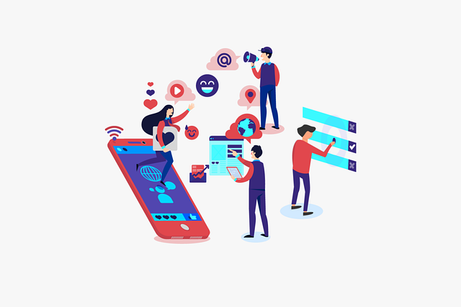
Action 4.2.2 Digital communication
4.1
4.2.1
Objectives
4.2
4.2.2
There are several ways of communication in the digital environment - from informal options like WhatsApp and Social Media to more formal ones like e-mail.
The next part will focus on communicating via e-mail or online form, as these are two good options to communicate in a more formally.
4.2.3
Source | Pixabay license

Slide 53
What communication tools are you using?
4.5 Digital communication
Click here to find some ways !
1. What ways of communication are you using in the digital environment?
WhatsApp
E-mail
Forum
Online form
Other …
2. How do you decide which type of communication to use?
Click here to find some types !
Depending on who is the receiver
Based on the topic
How to sent the information
Source | Pixabay license

Slide 54
Type of communications
4.5 Digital communication
We can say that the communication could be:
informal, like the way we communicate with people we are very close to, e.g., our family members and friends
formal, which include an official way of communication with organizations and people we do not know
semi-formal, that is a between informal and formal, e.g., you may consider to using this type in a forum
informal
formal

Slide 55
How to communicate with an organization or professionals
4.5 Digital communication
Each organization or professional has its contact data either to its website - look for the “Contact” area - or/and a business card.
The contact data usually contain:
e-mail address, which you may use for sending an e-mail in a formal way
online form, which you may use for writing a text in a formal way and submitting it
online form with calendar, which you may use for scheduling, online, your appointment
Please note that for the above you need a valid e-mail account (address)!
a call number, which you may use for calling via your regular or mobile phone.
do not send an SMS or any message via WhatsApp, Viber or other apps, unless the professionally allows it in your face to face appointment

Slide 56
Attention
4.5 Digital communication
Be careful!
Do not send via e-mail or post to an online form sensitive personal data, such as health data!

Slide 57
Practical Activity: Set-up an e-mail account
4.5 Digital communication
Activity
Practical Activity 1: Everyone creates a personal e-mail address.
Decide where to create a personal e-mail account
yahoo.de; googlemail.com; etc
Use a serious name for your e-mail account
e.g., first name and surname: maxmustermann@yahoo.de; instead of maxiking85@yahoo.de)
Create a safe password
Make it long
Use a mix of characters
Don’t use memorable keyboard paths (like: qwerty)
More information: [7]

Slide 58
Practical Activity: Find e-mail addresses
4.5 Digital communication
Activity
Practical Activity 2: Please find e-mail addresses related to the following topics:
You want to get a vaccination against COVID-19.
You want to know the e-mail address of your doctor or a Healthcare-related service
Source | Pixabay license

Slide 59
Practical Activity: Find an online form
4.5 Digital communication
Activity
Practical Activity 3: Please find online forms related to the following topics:
You want to schedule a vaccination against COVID-19.
You want to communicate with your doctor or a Healthcare- related service via an online form.
Source | Pixabay license

Slide 60
Linkage to Module 6
4.5 Digital communication
Module 6 - „Being active in the digital environment” deals with writing emails and forum posts

Slide 61
Action 4.2.3 Closure
4.1
4.2.1
Objectives
4.2
4.2.2
Let’s summarize …
Summary
Doubts and questions?
Explanation of the online session
4.2.3

Slide 62
4.6 Closure
Digital devices
Summary
In this module you have learned:
What the difference between different digital devices is
How to search on the internet
Some concepts and basic tips on security and privacy in the digital environment
About some tools for formal communication in the digital environment
Security and Privacy
Searching on the internet
Formal
communication

Slide 63
4.6 Closure
Doubts and questions?
Now it´s time to discuss your questions and to clarify any doubts!
Source | Pixabay license

Slide 64
4.6 Closure
Explanation of the online session
Let‘s explain how to use the online training service!
Source | Pixabay license

Slide 65
References and further reading
[1] Carretero Gomez, S., Vuorikari, R. and Punie, Y. (2017). DigComp 2.1: The Digital Competence Framework for Citizens with eight proficiency levels and examples of use. Publications Office of the European Union, Luxembourg. https://publications.jrc.ec.europa.eu/repository/bitstream/JRC106281/web-digcomp2.1pdf_%28online%29.pdf
[2] Leibniz-Institut für Wissensmedien. (2015, 8th of July). Search operators [Suchoperatoren]. https://www.e-teaching.org/didaktik/recherche/operatoren
[3] European Commission [2022]. What is personal data? https://ec.europa.eu/info/law/law-topic/data-protection/reform/what-personal-data_en
[4] Klicksafe. (2022). Desinformation and opinion. https://www.klicksafe.de/en/desinformation-und-meinung/
[5] Federal Ministry of health [Bundesministerium für Gesundheit]. (2022). https://www.bundesgesundheitsministerium.de/index.html
[6] VigiAccess. (2021). http://www.vigiaccess.org/
[7] Empey, C. (2018). How to create a strong passwor? Avast. https://blog.avast.com/strong-password-ideas/

Slide 66
Annex
Here you can find some additional information on the topics discussed in module 4.
Content:
Annex 1: What is the World Wide Web?
Annex 2: Security: Tips for protecting data and devices
Annex 3: Summary of differences between security and privacy
Annex 4: What is and who must comply with the GDPR?

Slide 67
What is the World Wide Web (WWW) (1)
4.3 Searching on the internet
Annex 1
The World Wide Web (WWW), or simply Web, is an information system that contains documents and other resources with information.
These Web documents or resources are
stored in Web servers
interlinked, over the internet, with other Web documents or resources through hyperlinks.
Source | Pixabay license

Slide 68
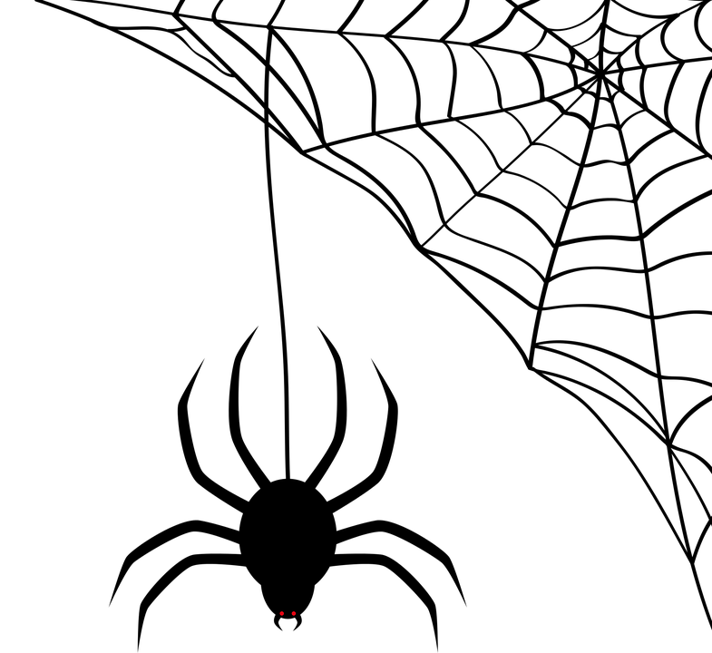
What is the World Wide Web (WWW) (2)
4.3 Searching on the internet
A website is a collection of related web resources including web pages, multimedia content, typically identified with a common domain name, e.g., google.com, and stored and published on a web server.
Millions of interlinked websites exist in all countries, forming with their hyperlinks the World Wide Web, like a spider web, that is why the world „web“ is used.
Source | Pixabay license

Slide 69
What is the World Wide Web (WWW) (3)
4.3 Searching on the internet
For accessing the Web, that is reaching the information stored on the websites, a software called web browser shall be used.
The web browser needs the domain name of a website for accessing it and uses the http (or https) protocol for exchanging data with the webserver, who hosts the website.
Find more information for WWW here.
browser
Web site
domain name
Internet
data exchange with http
Web
server
Source | Pixabay license

Slide 70
The World Wide Web is an information system which contains documents and other resources with information.
True
False

Slide 71
Annex 2
4.4 Security and Privacy
Security: Tips for protecting data and devices
Use a strong password
Long
Mix of characters
Don’t use memorable keyboard paths (like: qwerty)
Use the latest versions of an operating system, install antivirus and firewall software and check for updates regularly.
Avoid downloading free software from sites that are not known or trusted. Download software only from well-known and trusted companies. Many free programs (applications) may deliver adware and spyware to a computer or mobile device.
More information: [6]

Slide 72
Security and Privacy
4.4 Security and Privacy
Annex 3
Security is about the safeguarding of data, whereas privacy is about the safeguarding of user identity.
For example, hospital and clinic staff use secure systems to communicate with patients about their health, instead of sending information via personal email accounts.
This type of data transmission is an example of security.
On the other hand, privacy provision might limit patient health record access to specific hospital staff members, such as doctors, nurses, and medical assistants.
We understand that it is
possible to have security without privacy,
personal data may be transmitted and stored to a website securely, but the website may sell them
but impossible to have privacy without security.
a hacker may have unauthorized access to your device, web server or your transmitted data and steal your personal data
Source | Pixabay license

Slide 73
What is and who must comply with the GDPR?
Annex 4
What is the GDPR?
The General Data Protection Regulation is a European Union law that was implemented May 25, 2018, and requires organizations to safeguard personal data and uphold the privacy rights of anyone in EU territory.
Who must comply with the GDPR?
Any organization that processes the personal data of people in the EU must comply with the GDPR.
“Processing” is a broad term that covers just about anything you can do with data: collection, storage, transmission, analysis, etc.
“Personal data” is any information that relates to a person, such as names, email addresses, IP addresses, eye color, political affiliation, and so on.
Even if an organization is not connected to the EU itself, if it processes the personal data of people in the EU (via tracking on its website, for instance), it must comply. The GDPR is also not limited to for-profit companies.
Source | Pixabay license
Source: https://gdpr.eu/faq/

Slide 74
Congratulations! You have completed this module!
The European Commission support for the production of this publication does not constitute an endorsement of the contents which reflects the views only of the authors, and the Commission cannot be held responsible for any use which may be made of the information contained therein.

