Slide 1
1
2
3
4
5
Module 2 Main health issues when landing in a new country
6
The European Commission support for the production of this publication does not constitute an endorsement of the contents which reflects the views only of the authors, and the Commission cannot be held responsible for any use which may be made of the information contained therein.
Notes:
This slide should be included in every activity; but the next four slides only need to be in the introduction part of each module

Slide 2
Partners
WESTFALISCHE HOCHSCHULE GELSENKIRCHEN, BOCHOLT, RECKLINGHAUSEN
GELSENKIRCHEN, GERMANY
www.w-hs.de
PROLIPSIS
ATHENS, GREECE www.prolepsis.gr
OXFAM ITALIA INTERCULTURA
AREZZO, ITALY
www.oxfamitalia.org/
UNIVERSITAT DE VALENCIA
VALENCIA, SPAIN
www.uv.es
COORDINA ORGANIZACIÓN DE EMPRESAS Y RECURSOS HUMANOS, S.L.
VALENCIA, SPAIN
coordina-oerh.com
media k GmbH
Bad Mergentheim, GERMANY
www.media-k.eu
AKADIMAIKO DIADIKTYO (GUnet)
ATHENS, GREECE
www.gunet.gr

Slide 3
Modules
1. What is Digital Health Literacy and its relevance
2. Main health issues when landing in a new country
3. National Health Systems
4. Turning digitally literate
5. Navigating the National Health System through internet
6. Being active in the digital health environment

Slide 4
Objectives
2
What are the main health issues when landing in a new country?
To understand the various risks to migrant health during all the stages of the migrant journey
To understand the cultural differences influencing health narratives between the country of origin and the host country
To use online tools that can facilitate understanding of health issues and country specific health related circumstances
To learn relevant to health country specific terminology and explore useful online tools
To understand the main health protective behaviours and learn how to find reliable relevant online sources
To learn relevant to health country specific terminology and explore useful online tools

Slide 5
Competences
2
What are the main health issues when landing in a new country?
Understanding differences about health and health treatment in the country of origin and the country of arrival
Understanding how culture can affect health narratives
Gaining knowledge on specific physical and mental health risks migrant populations are at risk of during the migrant journey, learn how to use relevant online sources
Gaining knowledge about specific prevention and health promotion strategies and use relevant online tools
Gaining awareness about digital health literacy’s relevance for migrants’ health
Source | Pixabay license

Slide 6
2.1 Introduction to this module
2.1
2.2
Objectives
2.3
Identifying the health-related risks before, during and after your journey to the host country
Exploring your physical and mental health
Learning about prevention strategies and how to use them to improve your health
Let’s start …
2.4

Slide 7
Introduction
2.1 Introduction
This module focuses on raising awareness about your health issues which are particularly prone to when arriving in a new country. Your trainer is expected to guide the group of learners in identifying and reflecting on factors which influenced your health before, during and after arrival in the new country. Each of these phases impact on the physical and mental health, and in some cases they are interrelated and mutually dependent.
Health issues are not only manifested in disease symptoms. They also have to do with language and terms, and different ways of dealing with illness. Behind symptoms and their description there are often also culture-specific narratives to be considered. The focus is how illness can be addressed using digital means.
Source | Pixabay license

Slide 8
Opening
2.1 Introduction
The trainer explains the session’s objectives, the duration, the organisation and the activities.
S/he encourages active participation.
S/he makes sure that each participant has access to a digital tool.
S/he explains the rules for the session.
S/he shortly presents the practical activities.
Source | Pixabay license

Slide 9
Action 2.2 Identify Health Risks before, during and after coming to a new country
2.1
2.2
Objectives
2.3
Identifying health risks in the country of your origin
Identifying health risks during the journey
Identifying health risks when arriving in the new country
2.4
Source | Pixabay license

Slide 10
Health risks at the countries of your origin
2.2 Risk factors for health issues
Social-economic status
Educational level
Genetic make-up
Local disease profile
Poor personal & food hygiene
Specific health conditions
Environmental push factors
Conflict, disasters & other traumatic events
Weak health care system
In your country of origin, health risks depend on many different factors: level of education, hygiene deficits, environmental factors, traumatic events such as environmental disasters or wars, inadequate health care due to a lack of financial resources or inadequate infrastructure.
Cultural differences can also play a role, e.g., a lack of appreciation of dental health or mental health.
Source

Slide 11
Health risks during the journey
2.2 Risk factors for health issues
Modes of travel
Legal or illegal border crossing
Environmental elements
Sexual & other violence, detention & other traumatic events
STDs, injuries & exposure to physical dangers and extreme environmental conditions
Unsanitary conditions & overcrowding
Inadequate nutrition
Poor personal and food hygiene
Many health risks are added to the exertion during the trip: months of exposure to stress, exposure to extreme heat or cold without appropriate clothing, injuries, unsanitary diet and inadequate sanitary facilities, sexual assault and other traumatic events.
Source

Slide 12
Health risks when arriving in a new country
2.2 Risk factors for health issues
Arriving in a new country is initially marked by relief: you have made it and you are safe. But adapting is difficult: existing clinical pictures worsen, unfamiliar dishes lead to nutritional difficulties, the insecure situation regarding residence status leads to mental problems, homesickness and fear for family members are part of everyday life.
In addition, there are drug intolerances, inadequate vaccinations, language difficulties when communicating symptoms of the disease.
Adaptation to new life, surroundings & culture
Collective accommodation
Uncertain legal status
Access to basic survival needs
Entitlement & access to health services
Susceptibility to new diseases
Environmental conditions
Social exclusion
Cultural, linguistic & legal barriers to access health services
Discrimination
Lack of access to healthy food
Source

Slide 13
Describe your experiences
2.2 Risk factors for health issues
Please watch a video: https://www.youtube.com/watch?v=eLbmUbj0edk
Discussion on the video
Does the video reflect your experiences?
Source | Pixabay license

Slide 14
Describe your experiences
2.2 Risk factors for health issues
Note down your health experiences in the three stages on the pin board or flipchart:
Stage 1: health risks at the countries of your origin
Stage 2: health risks during the journey
Stage 3: health risks when arriving in a new country
Source | Pixabay license

Slide 15
Describe your experiences
2.2 Risk factors for health issues
Create a priority list of each stage according to the relevance for your life and health
There might be differences according to country of origin; please group the experiences based on similarities and differences
Take notes of the outcome as this will be reflected in your homework
Source | Pixabay license

Slide 16
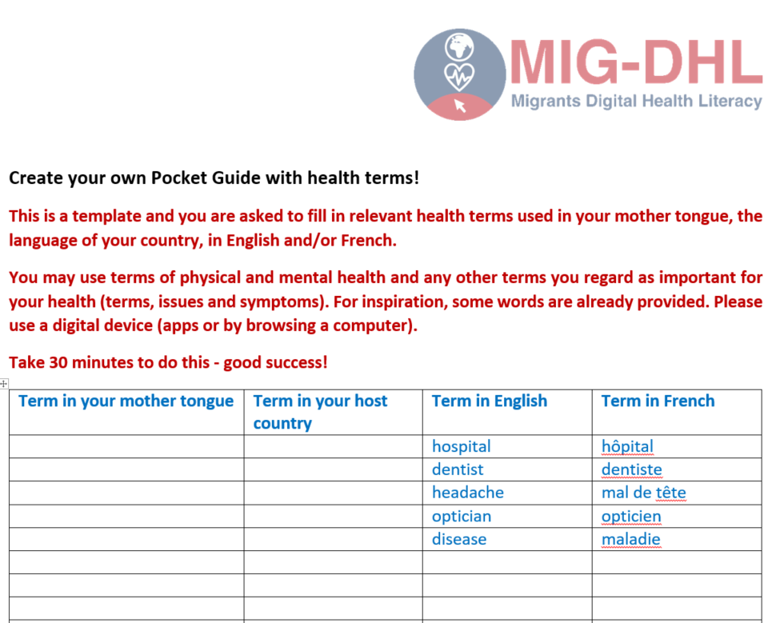
Your homework
2.2 Risk factors for health issues
For your homework, please create your own pocket guide with health terms
Please use the provided template to look for terms of physical and mental health and any other issues you regard as important for your health
Search online for the right expressions
Download the Pocket Guide from here !

Slide 17
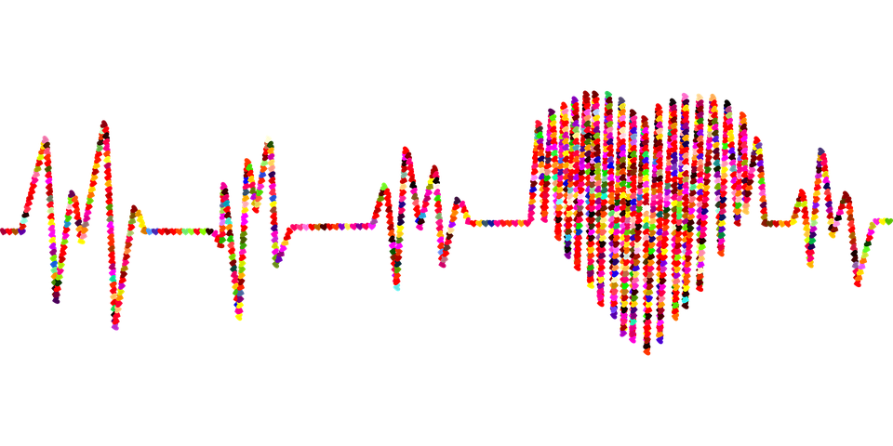
Action 2.3
Exploring the physical and mental health of migrants
2.1
2.2
Objectives
Exploring your illness narratives
Introducing symptoms of health and mental health issues that are more prevalent in the migrant population
Identifying through the symptoms the diseases and suggesting specific (digital) actions
2.3
2.4
Source | Pixabay License

Slide 18
Exploring your illness narratives
2.3 Exploring the physical and mental health of migrants
The perception of illness and the way it is dealt with can be very different depending on the cultural background. Symptoms of illness are interpreted differently and the point at which medical help is required can also vary. The assessment of when home remedies are sufficient and when a doctor should be consulted can differ culturally.
Communication of illnesses also varies: there are illnesses that are shared with friends and others that are treated as taboo. The recovery process is also subject to different characteristics: e.g., does a sick person withdraw from family life or does the family play a role in recovery? What role does digital help play and how is it used?
Source | Pixabay License

Slide 19
Symptoms that are more prevalent in the migrant population
2.3 Exploring the physical and mental health of migrants
There are a number of diseases that occur more frequently in migrant populations. According to a WHO study, these include, above all, infectious diseases like tuberculosis, HIV infection and viral hepatitis, respiratory diseases, vector-borne diseases.
The following non-communicable diseases are also observed disproportionately: cardiovascular diseases, diabetes, cancer and chronic lung diseases, many of them require the provision of continuous care over a long time, often for life.
Source

Slide 20
Identifying the disease and suggesting specific actions (1)
2.3 Exploring the physical and mental health of migrants
Most probably, you are aware of diseases that occur more frequently, but how to deal with them in order to maximise chances of recovery is not always clear. It is also often unclear at what point medical help and medication is absolutely necessary to alleviate symptoms and avoid subsequent health damage. This may also be related to cultural differences about which you as well as health workers in the host country must first be aware.
Source | Pixabay License

Slide 21
Identifying the disease and suggesting specific actions (2)
2.3 Exploring the physical and mental health of migrants
Medical treatment can be provided in different ways: in a doctor's practice, by a doctor visiting you in your home, in a hospital emergency room and digitally. Pharmacies offer advice for minor health problem. Without an appointment, you will always find help in a hospital emergency room, but some doctor's surgeries also offer this. Normally, you will make an appointment in a timely manner.
Source | Pixabay License

Slide 22
Identifying the disease and suggesting specific actions (3)
2.3 Exploring the physical and mental health of migrants
More and more doctors are also offering digital treatment, especially in times of a pandemic. However, a prerequisite for this is that your data is stored in the practice and, as a rule, the doctor would like to have already recorded your health status.
The advantage of digital treatment is that you can also receive it via your mobile phone and do not have to come to a doctor's practice.
Source | Pixabay License

Slide 23
Dealing with mental illness
2.3 Exploring the physical and mental health of migrants
Mental illnesses are becoming increasingly identifiable and treatable thanks to refined diagnostic methods, but access to counselling, treatment and therapy (face-to-face and online) is not always possible at short notice. Refugees with post-traumatic stress are a vulnerable group for whom few preventive and therapeutic measures are available. Integrative, culturally sensitive approaches to treating refugees face complex challenges, such as cultural and language barriers, which require specialisation on the part of medical experts.
Read more in Annexes II and III !
Source | Pixabay License

Slide 24
Describe your experiences
2.3 Exploring the physical and mental health of migrants
Discuss narratives identifying through the symptoms diseases and suggesting treatments
Consider mental problems as well
Use digital sources
You may work in smaller groups if necessary
Source | Pixabay License

Slide 25
Describe your experiences
2.3 Exploring the physical and mental health of migrants
Identify health problems which you have experienced yourself.
Note the outcome on pin boards, computers or any other appropriate method or device and present it in the final meeting.
In case of two groups: nominate one or two rapporteur/s who present/s the outcome to the whole group at the end of the session.
But:
This is a learning exercise and you should always consult your doctor for the diagnosis and especially for the treatment!
Source | Pixabay License

Slide 26
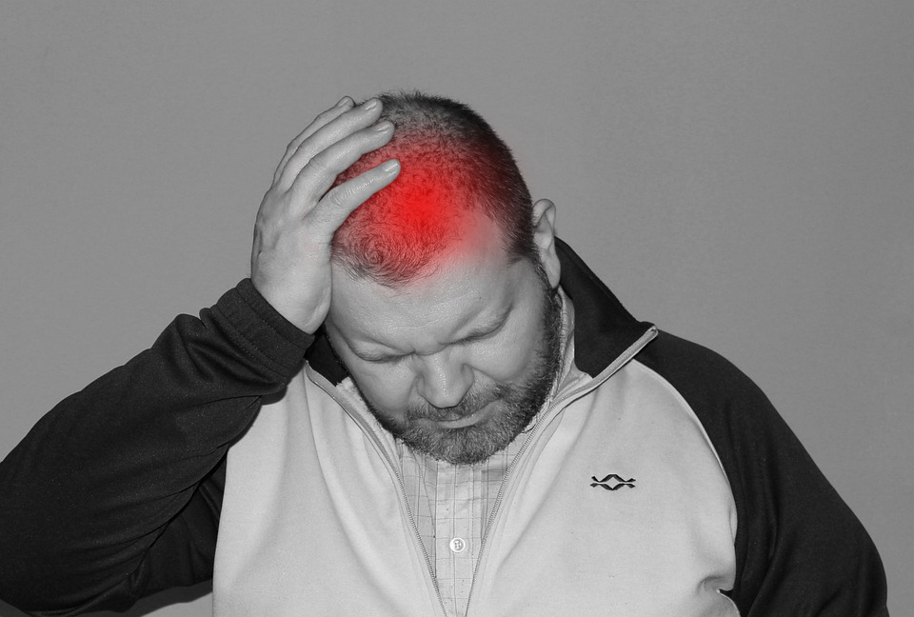
Describe your experiences: guiding questions
2.3 Exploring the physical and mental health of migrants
You may use the following questions:
Symptoms: What is the health problem?
Reason: What do you think has caused the health problem? Why do you think it started when it did?
Severity: To what extent does it limit the quality of your life?
Duration: How long have there been symptoms?
Treatment: Can the health problem be treated by yourself or do you need to see a doctor?
Impact: What are the main problems caused?
Fear: What do you fear most about the health problem?
Source | Pixabay License

Slide 27
Describe your experiences
2.3 Exploring the physical and mental health of migrants
Discuss when help is recommended
Identify which doctor is the right in handling the health problem (e.g. GP, ophthalmologist, dentist)
Identify health problems when immediate handling might be necessary (e.g. by calling an emergency doctor or an ambulance)
Source | Pixabay License

Slide 28
What is a serious health risk when arriving in a new country?
Only one answer is correct!
A. Headache
B. Cold
C. Mosquito bite
D. Inadequate vaccinations
Notes:
D

Slide 29
In the countries of migrants’ origin, health risks depend on...
Only one answer is correct!
A. Local retailers
B. Neighbours
C. Pets
D. Level of education
Notes:
D

Slide 30
Illness can be treated…
Only one answer is correct!
A. In a doctor’s practice, hospitals, medical centers, pharmacies, at a homoeopathic practitioner
B. In a supermarket, a market hall and any food stalls
C. In the employment agency
D. In hospitals only
Notes:
A

Slide 31
In case of illness, digital help ...
Only one answer is correct!
A. Is not offered by doctors
B. Is a possible treatment
C. Is the best way for diagnosis
D. Is always credible
Notes:
B

Slide 32
Digital treatment can happen via
Only one answer is correct!
A. Mobile phones, tablets, desktop computers
A. Is not offered by doctors
C. Shouting for help out of the window
D. Any person who has a computer
Notes:
B

Slide 33
Health risks when arriving in a new country include that
Two answers are correct!
A. existing clinical pictures worsen
B. Land lines without displays
C. Injuries from car accidents are not treated at all
D. unfamiliar dishes lead to nutritional difficulties
Notes:
A,D

Slide 34
A doctor is not necessary when you follow advice on the internet.
True
False
Notes:
False

Slide 35
Health treatment is provided by doctors only in case of employment.
True
False
Notes:
False

Slide 36
Online treatment is not possible for mental diseases.
True
False
Notes:
False

Slide 37
Match the columns
Match the columns !
The perception of illness and the way it is dealt with
but access to counselling, treatment and therapy is not always possible at short notice.
Mental illnesses are becoming increasingly identifiable and
e.g., level of education, hygiene deficits, environmental factors, traumatic events.
A general practicioner (GP)
can be very different depending on the cultural background.
Health risks depend on many different factors
is the first contact point for all health problems.
Notes:
A→3
B→1
C→4
D→2

Slide 38
2.1
Action 2.4
Prevention strategies
2.2
Objectives
2.3
Learning about disease prevention
Exploring the most common prevention strategies
Understanding the importance of adopting prevention strategies
2.4
Source | Pexels license

Slide 39
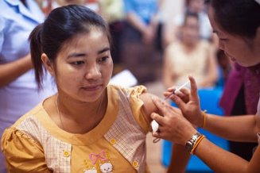
Vaccination
2.4 Prevention strategies
Why is it important for me to be vaccinated?
Protects you from future exposure to serious and deadly diseases caused by viruses or bacteria
Reduces the risk of getting a disease by working with your body’s natural defences to build protection (WHO)
Prevents and controls infectious-disease outbreaks e.g. Corona Virus
Prevents more than 20 life-threatening diseases (WHO)
Prevents 2 to 3 million deaths every year (WHO) and protect individuals, communities and populations – Some illnesses like Smallpox were globally eliminated through vaccination.
A vaccinated persons is less likely to pass on an infectious disease to others. So, people who get vaccinated help protect those who cannot be vaccinated themselves. (European Commission)
Source | Pexels license
Notes:
World Health Organization. (2019). Vaccines and immunizations. https://www.who.int/health-topics/vaccines-and-immunization#tab=tab_1. Accessed 17 Jan 2022
World Health Organization .(2021). Vaccines and immunization: What is vaccination? https://www.who.int/news-room/questions-and-answers/item/vaccines-and-immunization-what-is-vaccination. Accessed 17 Jan 2022
World Health Organization. (2019). https://www.who.int/news-room/facts-in-pictures/detail/immunization. Accessed 17 Jan 2022
European Commission. (2020). The health benefits of vaccination. https://ec.europa.eu/commission/presscorner/detail/en/fs_20_2364. Accessed 17 Jan 2022

Slide 40
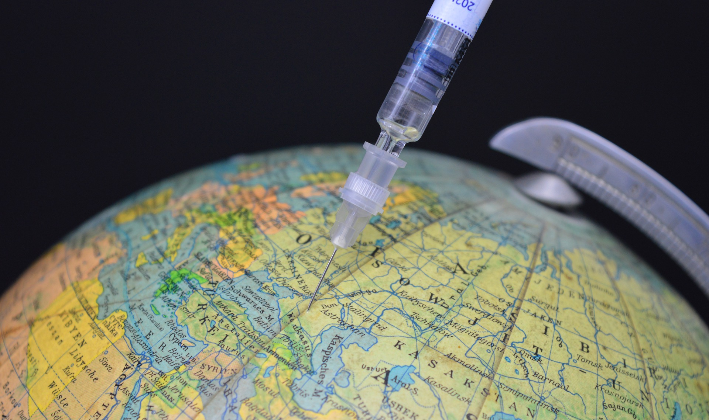
Vaccination
2.4 Prevention strategies
Are vaccines safe?
All countries have a National Immunization Programme to protect the population against vaccine-preventable diseases (UNICEF)
All vaccines used in national immunization programmes are safe and effective (WHO)
Most side effects are minor and short-lived
Source | Pixabay license
Notes:
1. UNICEF .(2020). Immunization. https://www.unicef.org/eca/health/immunization. Accessed 17 Jan 2022
2. World Health Organization .(2013). Vaccine Safety Basics: Learning Manual. SAFETY. https://www.who.int/vaccine_safety/initiative/tech_support/Vaccine-safety-E-course-manual.pdf. Accessed 17 Jan 2022

Slide 41
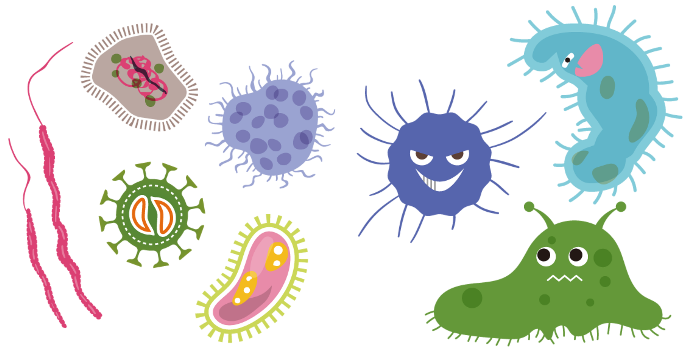
Vaccine-Preventable Diseases
2.4 Prevention strategies
When I get vaccinated I can be protected from:
Tubercle bacillus
Poliovirus
Diphtheria
Tetanus
Pertussis
Measles
Hepatitis A/B
Rotavirus
Yellow fever virus
HPV
COVID-19
related videos
Source | Pixabay license

Slide 42
Nutrition
2.4 Prevention strategies
Why is it important for me to have a good nutrition?
Nutrition is extremely important for your health and for the development of human beings
Good nutrition is related to better infant and maternal health, stronger immune systems, safer pregnancy and child birth, and lower risk of non-contagious diseases (WHO).
Poor nutrition can lead to malnutrition - a condition of not getting enough or getting too much of a nutrient or nutrients.
Malnutrition is a serious threat to human health and includes both undernutrition and overweight
Source | Pixabay license
Notes:
1. World Health Organization .(2018). Nutrition. https://www.who.int/news-room/facts-in-pictures/detail/nutrition. Accessed 16 Jan 2022
2. John Hopkins Medicine .(n.d.). Malnutrition. https://www.hopkinsmedicine.org/health/conditions-and-diseases/malnutrition. Accessed 16 Jan 2022

Slide 43
Signs of Malnutrition
2.4 Prevention strategies
Undernutrition signs:
Weight loss
Lowered appetite
Fatigue/Weakness
Frequent illness
Reduced concentration
Poor wound healing
Hair thinning
Mood disruptions (Johns Hopkins Medicine)
Overnutrition signs:
Weight gain
Diabetes
High blood pressure
High cholesterol
Inflammation
Notes:
1. John Hopkins Medicine .(n.d.). Malnutrition. https://www.hopkinsmedicine.org/health/conditions-and-diseases/malnutrition. Accessed16 Jan 2022

Slide 44
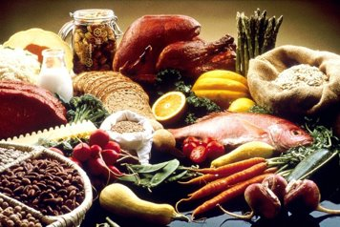
Treating and Preventing Malnutrition
2.4 Prevention strategies
What can I do to prevent malnutrition?
Treat malnutrition: foods rich in nutrients – eat plenty foods such fruits and vegetables, whole grains and lean proteins
Treat overnutrition: reduce overall calories and improving the balance of your diet
Treat undernutrition: increase overall calories by adding food rich in nutrients
Avoid junk foods which are high in calories but have little nutritional value
Source | Pixabay license
Notes:
1. Saunders J, Smith T,. (2010), Malnutrition: causes and consequences. Clin Med. 2010;10(6):624-627. doi:10.7861/clinmedicine.10-6-624
https://www.rcpjournals.org/content/clinmedicine/10/6/624
2. Carr T.P et al .(2016). Advanced Nutrition and Human Metabolism. Cengage Learning; 2016.
3. Johns Hopkins Medicine - https://www.hopkinsmedicine.org/health/wellness-and-prevention/abcs-of-eating-smart-for-a-healthy-heart

Slide 45
Preparing Meals at Low Budget
2.4 Prevention strategies
How can I plan and prepare nutritious meals without spending a lot of money?
1. Plan your meal
Choose some recipes
Make a list of all ingredients
Prioritize according to nutritional value and price.
Balance out the most expensive foods
Limit processed foods
Plan at least one meal without meat a week
Plan meals around foods that are on sale
Plan to use leftovers
2. Consider farmer’s markets
Local, fresh and in-season produce
‘Green’ and ‘organic’ fruits and vegetables
Form relationships with growers/farmers
3. Adopt "cheap" Eating Habits
Buy fresh foods and process them yourself
Invest in food storage utensils
Eat in restaurants only on rare occasions
Learn to cook from scratch
Don't waste your food - Freeze it
Eat grains more often
Use bigger quantities of cheap food
TIPS
Carry small change (cash) and shopping bags with handles
Consider the shopping time – you might get even lower prices when farmers are getting ready to leave
More information: https://www.sunriseseniorliving.com/blog/july-2020/5-tips-for-shopping-a-farmers-market-this-summer.aspx

Slide 46
Smoking and Drinking Alcohol
2.4 Prevention strategies
Similar to poor nutrition, smoking tobacco and excessive alcohol use are some of the main causes of preventable diseases
Effects of smoking
Main risk factor for most of the leading causes of death
1.6 million people die every year because of smoking in Europe (WHO)
Impact on diseases such as: cancer, cardiovascular disease, high blood pressure, eye damage, osteoporosis, tooth and gum disease
Quitting smoking
Life expectancy, breathing, health and overall well-being can be improved
Quit smoking Apps: QuitNow, Smoke Free and quitSTART
Source | Pixabay license
Notes:
1. National Institute on Alcohol Abuse and Alcoholism(2007). - Alcohol and Tobacco https://pubs.niaaa.nih.gov/publications/aa71/aa71.htm. Accessed 17 Jan 2022

Slide 47
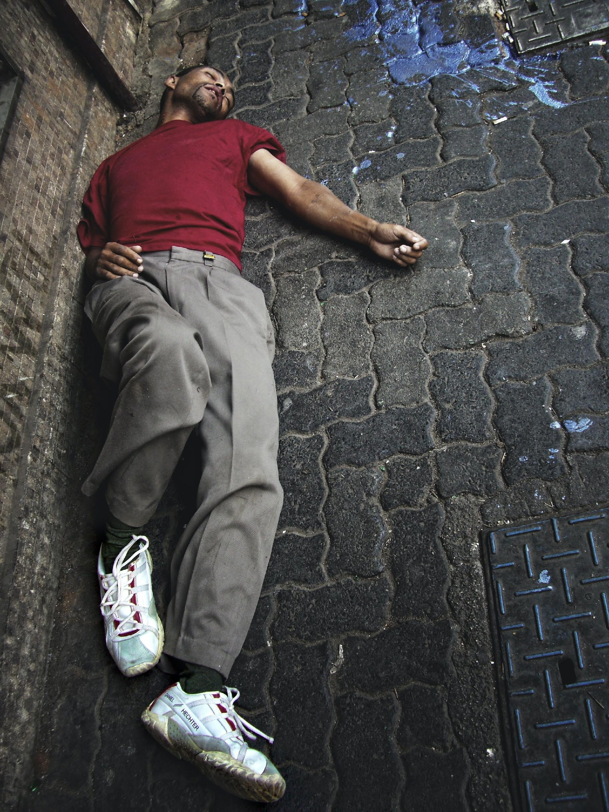
2.4 Prevention strategies
Smoking and Drinking Alcohol
Effects of excessive alcohol use
Causal factor for over 200 diseases including seven types of cancer, neuropsychiatric disorders, cardiovascular diseases, cirrhosis of the liver and several infectious diseases
Across the WHO European Region, alcohol causes almost 1 million deaths annually, contributing significantly to unintentional and intentional injuries. (WHO).
Alcohol is never safe for pregnant women
Prenatal alcohol exposure can cause defects which include physical, mental, behavioural and/or learning disabilities with possible lifelong implication of the baby/child (WHO)
Source: WHO/Europe
Source | Unsplash license
Notes:
WHO/Europe - https://www.euro.who.int/en/health-topics/disease-prevention/alcohol-use#:~:text=Across%20the%20WHO%20European%20Region,to%20unintentional%20and%20intentional%20injuries.

Slide 48
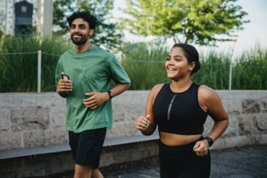
Physical Activity
2.4 Prevention strategies
What is physical activity?
“Any bodily movement produced by skeletal muscles that requires use of energy” (WHO)
Children, adolescents, and adults of all ages need to stay active throughout all stages of their lives
WHO guidelines and recommendations provide details for different age groups and specific population groups on how much physical activity is needed for good health
Source | Pixabay license

Slide 49
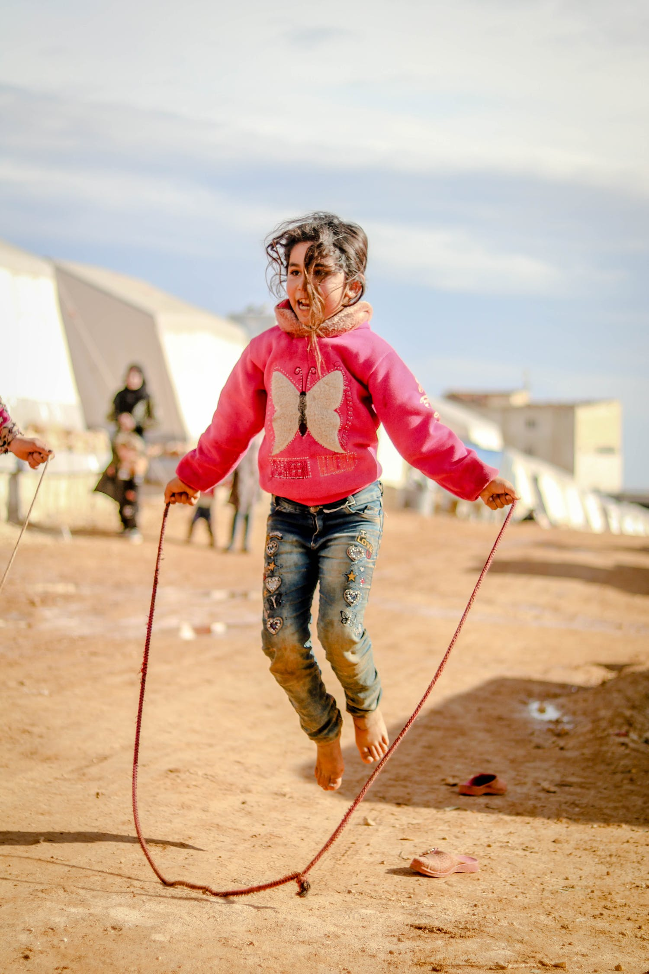
Benefits of Physical Activity
2.4 Prevention strategies
How can I benefit from physical activity?
Increases life expectancy - Regular physical activity reduces the risk of premature mortality
Improves quality of life
Improves respiratory , cardiovascular and general health (WHO)
Reduces feelings of anxiety and depression
Improves mood and mental health
Reduces risk of injury – regular exercise increases muscle strength, bone density, flexibility and stability (WHO)
Saves money from health care costs.
Improves quality of sleep
Helps you control your weight
Improves memory and brain function for all age groups
Source | Pixabay license

Slide 50
Examples of Physical Activities
2.4 Prevention strategies
Physical Exercises
Walking/Jogging/Running
Dancing
Swimming
Aerobics
Bicycle riding
House Chores
Gardening
Cleaning
Outdoor Activities
Playing at the park
Hiking/rock climbing
Football/Basketball
Step counter app/Pedometer

Slide 51
Screening for Special Diseases
2.4 Prevention strategies
Why should I have regular screening tests for special diseases?
To early detect potential health disorders or diseases in people without any symptoms of a disease
To reduce the risk of disease and treat it most effectively
Screening tests are not 100% accurate in all cases, however, it is more valuable to have the tests at appropriate times than not having them at all
Source: John Hopkins Medicine
Notes:
John Hopkins Medicine - https://www.hopkinsmedicine.org/health/treatment-tests-and-therapies/screening-tests-for-common-diseases

Slide 52
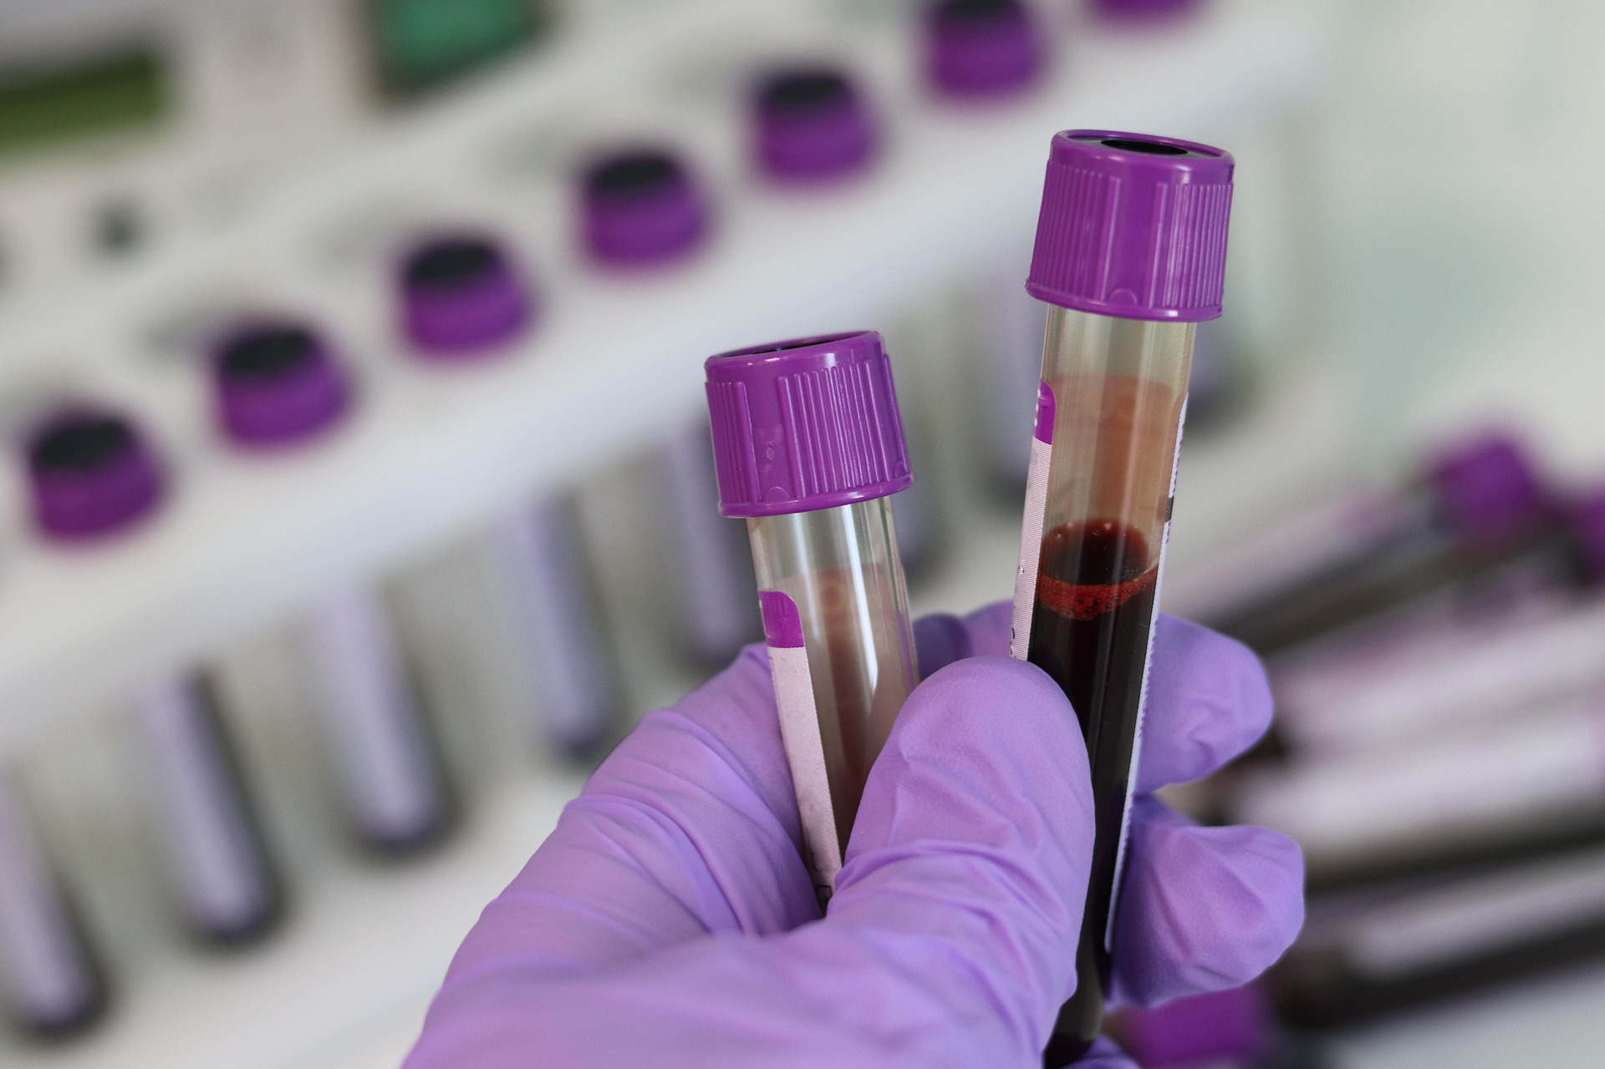
Common Screening Tests
2.4 Prevention strategies
Appropriate timing and frequency of screening tests are done based on age, overall health and medical history
Common screening tests include:
Cholesterol measurements
Pap Smear
Mammography
Diabetes or prediabetes
Sexually Transmitted Diseases
Source | Pixabay license
For More information CLICK here!
Notes:
Johns Hopkins Medicine - (https://www.hopkinsmedicine.org/health/treatment-tests-and-therapies/screening-tests-for-common-diseases)

Slide 53
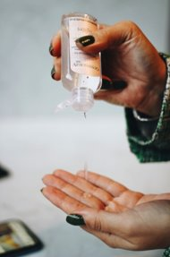
Hygiene Principles
2.4 Prevention strategies
How can I help to stop the spread of diseases during a pandemic?
Personal Safety Practices
Physical distancing
Face coverings
Gloves
Hand hygiene (ECDC)
Coughing and sneezing hygiene
Personal disinfection
Personal accommodation (WHO)
Source 1: European Centre for Disease Prevention and Control (ECDC). (2020).
Source | Unsplash license
Source 2: WHO
Notes:
1 European Centre for Disease Prevention and Control. (2020). Guidance on infection prevention and control of coronavirus disease (COVID-19) in migrant and refugee reception and detention centres in the EU/EEA and the United Kingdom – June 2020. ECDC: Stockholm; 2020. Accessed 16 Jan 2022
https://www.ecdc.europa.eu/sites/default/files/documents/COVID-19-guidance-refugee-asylum-seekers-migrants-EU.pdf Accessed 16 Jan 2022
2. WHO. (n.d.). Chapter 8 - Personal, domestic and community hygiene. https://www.who.int/water_sanitation_health/hygiene/settings/hvchap8.pdf. Accessed 16 Jan 2022

Slide 54
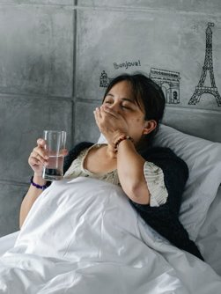
Targeted Hygiene
2.4 Prevention strategies
What hygiene practices should I adopt?
You should focus on hygiene practices at the times when harmful microbes are most likely to be spreading (WHO).
These moments include when you:
Handle food
Eat with your fingers
Use the toilet or change a baby’s diaper
Cough sneeze and blow your nose
Care for domestic animals
Handle and launder dirty clothing and household linens
Handle and dispose rubbish (WHO)
Source | Pexels license

Slide 55
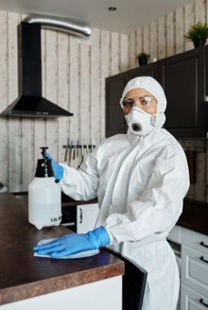
How to Break the Chain of Infection
2.4 Prevention strategies
The main goal of a hygiene practice is to reduce the number of "bad" microbes on hands, surfaces and fabrics to a level which is not harmful to health.
HOW CAN THIS BE DONE?
Removal of the microbes from the surfaces using cleaning products and utensils under running water.
Inactivation of the microbes on the surfaces using products like disinfectants, hand sanitizers and heat (WHO).
Source | Pexels license
Source: International Scientific Forum on Home Hygiene. (2018).
Notes:
1. International Scientific Forum on Home Hygiene. (2018). Containing the burden of infectious diseases is everyone’s responsibility: A call for an integrated strategy for developing and promoting hygiene behaviour change in home and everyday life [White Paper]. (n.p.). https://www.ifh-homehygiene.org/sites/default/files/publications/IFH%20White%20Paper-10-18.pdf. Accessed 16 Jan 2022

Slide 56
Which of the following is a non- vaccine preventable disease.
Only one answer is correct!
A. Rotavirus
B. Tetanus
C. Covid 19
D. Giardiasis
Notes:
D

Slide 57
Match the columns
Match the columns !
Hygiene practices
improves memory and brain function for all age groups
Physical Activity
reduce the number of harmful microbes on hands, surfaces and fabrics
Vaccination
reduce the number of harmful microbes on hands, surfaces and fabrics
Notes:
A→3
B→1
C→2

Slide 58
Which are the overnutrition signs?
Two answers are correct!
A. Weight gain
B. Hair thinning
C. High blood pressure
D. Weight loss
Notes:
A, C

Slide 59
ANNEX I: ADDITIONAL INFORMATION ON WOMEN’S HEALTH

Slide 60
Women’s Health
Annex I: Additional Information on Women‘s Health
What if I get pregnant or become sick. Will I have access to quality affordable healthcare?
Some health issues affect women differently and more commonly than men
Women bear exclusive health conditions such as breast cancer, cervical cancer, menopause and pregnancy issues
In addition, women suffer higher heart attack deaths compared to men, and they are more likely to have depression or anxiety
Women are more likely to have urinary tract conditions and they also suffer more with present more sexually transmitted diseases
While most conditions present frequently in women, some illnesses pose huge health risks

Slide 61
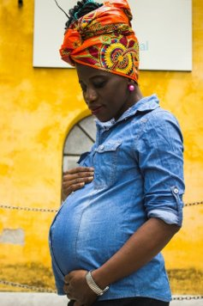
Women’s Health
Annex I: Additional Information on Women‘s Health
Depression and Anxiety
Natural hormonal fluctuations can cause depression or anxiety. Pre-menstrual syndrome occur often among women, also, many women develop a form of depression after birth called “baby blues”
Perimenopause in women can also cause depression
Pregnancy Issues
Pregnancy can cause a healthy woman’s red blood cells to drop or lead to depression
Also , pre-existing conditions such as Asthma, Diabetes, and Depression can worsen the pregnancy and threaten the health of the mother and her child
Source | Pexels license

Slide 62
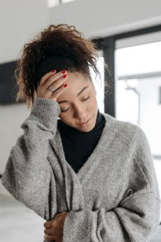
Women’s Health
Annex I: Additional Information on Women‘s Health
Autoimmune diseases
This occurs when body cells that eliminate threats such as viruses, attack healthy cells
The condition affects women with symptoms such as exhaustion, mild fever, pain, skin irritation and Vertigo. (U.S Department of Health and Human Services)
Gynecological Health
Bleeding and discharge are a normal part of the menstrual cycle, however, vaginal issues can also indicate serious problems such as STDs and reproductive tract cancer. Unchecked mild infections can cause infertility or kidney failure.
Source | Pexels license
More information: https://northeast.jeffersonhealth.org/

Slide 63
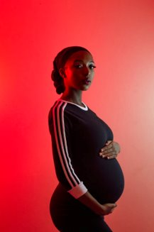
Special Care in Pregnancy
Annex I: Additional Information on Women‘s Health
What resources are available to help me throughout my pregnancy?
Pregnancy care consists of prenatal (before birth) and post-partum (afterbirth) health care for mothers who are expecting their babies
During this time, mothers go through treatments and trainings to ensure a healthy pre-pregnancy, pregnancy, labor and delivery for mother and baby
Source | Unsplash license

Slide 64
Special Care in Pregnancy
Annex I: Additional Information on Women‘s Health
Prenatal
Prenatal care begins at least three months before conception and it is about adopting healthy habits such as not smoking and taking alcohol, taking dietary supplements, taking folic acid supplements and avoiding all contact with toxic substances
This reduces risks during pregnancy and increases the chance of a safe and healthy delivery
Notes:
Center for Disease Control and Prevention (CDC) - https://www.cdc.gov/ncbddd/birthdefects/prevention.html Accessed 17 Jan 2022

Slide 65
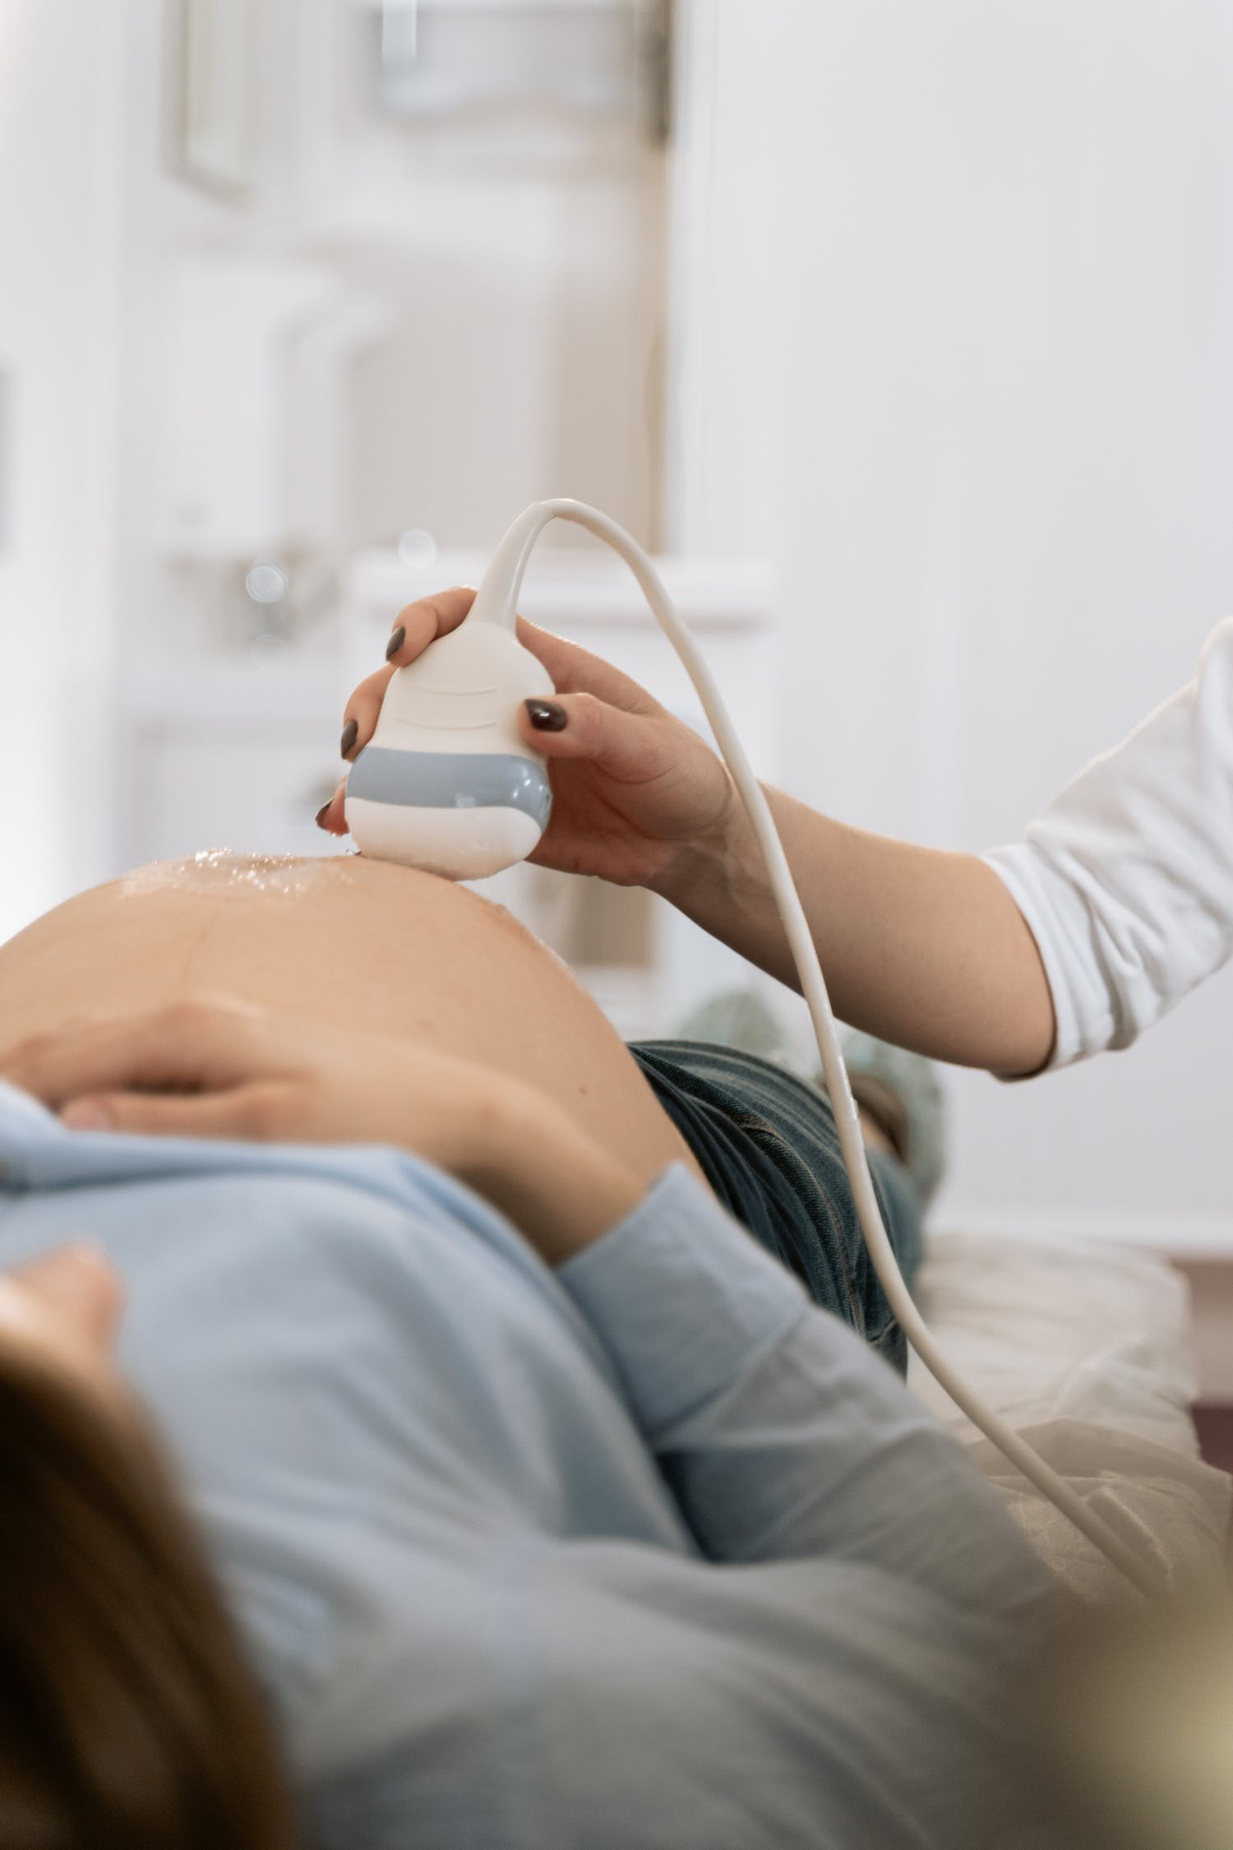
During Pregnancy (1)
Annex I: Additional Information on Women‘s Health
A mother should schedule regular healthcare throughout each stage of pregnancy, for example:
Every month in the first 6 months of pregnancy
Every 2 weeks in the 7th and 8th months of pregnancy
Every week during the 9th month of pregnancy
Source | Pexels license
Notes:
Center for Disease Control and Prevention (CDC) - https://www.cdc.gov/pregnancy/during.html. Accessed 17 Jan 2022

Slide 66
During Pregnancy (2)
Annex I: Additional Information on Women‘s Health
Routine checks and tests
Routine tests and screenings such as blood test for anemia, HIV and blood type
Monitoring blood pressure
Measuring weight gain
Monitoring baby’s growth and heart rate
Monitoring special diet and exercise
Recommend special classes at different stages of pregnancy

Slide 67
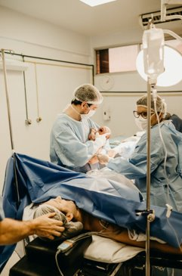
During Delivery
Annex I: Additional Information on Women‘s Health
Routine checks and tests
During labour and delivery it is very important that mothers cooperate with the healthcare assistants in avoiding and treating any possible complications and optimizing postnatal outcomes
Care should include skilled care at birth, through obstetric care and management of preterm birth
Source | Pexels license

Slide 68
https://www.youtube.com/watch?v=S7qO_9-NJmA
Annex I: Additional Information on Women‘s Health

Slide 69
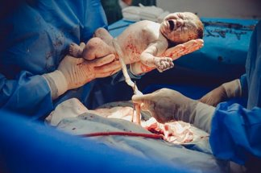
Essential Elements of Newborn Care (1)
Annex I: Additional Information on Women‘s Health
How can I protect my newborn right after labour?
1) Immediate and thorough drying
Dry the baby in a warm towel then transfer the infant into a second warm dry towel to prevent hypothermia and also to stimulate the infant to cry
Do an initial examination to assess the infant for size, gender, gross congenital abnormalities or other obvious clinical problems
2) Clamping the Umbilical Cord
Delay the cord clamping to 2 minutes after birth, also allow the infant to cry a few times before clamping the cord, for the baby to receive some extra blood from the placenta.
The extra blood will prevent iron deficiency anemia later in the first year of life
Clamp the cord 3 or 4 cm from the infant’s abdomen.
Source | Pexels license
Notes:
Bryce, E., Mullany, L.C., Khatry, S.K. et al. Coverage of the WHO’s four essential elements of newborn care and their association with neonatal survival in southern Nepal. BMC Pregnancy Childbirth 20, 540 (2020). https://doi.org/10.1186/s12884-020-03239-6

Slide 70
Essential Elements of Newborn Care (2)
Annex I: Additional Information on Women‘s Health
3) Skin to Skin Contact
The mother should see and hold the baby as soon as possible after delivery for an important stage of bonding
An infant appearing normal should be placed on mother’s abdomen waiting to be dried, umbilical cord clamped, and the initial examination made.
Then moved into kangaroo position between mother’s breasts
Bonding is the emotional attachment that develops between mother and child, an important step towards good parenting.
Notes:
Bryce, E., Mullany, L.C., Khatry, S.K. et al. Coverage of the WHO’s four essential elements of newborn care and their association with neonatal survival in southern Nepal. BMC Pregnancy Childbirth 20, 540 (2020). https://doi.org/10.1186/s12884-020-03239-6

Slide 71
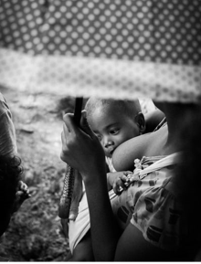
Essential Elements of Newborn Care (3)
Annex I: Additional Information on Women‘s Health
4) Early initiation of breastfeeding
A mother should put infant to her breasts immediately after delivery, studies have shown that there’s a greater chance the mother will breastfeed successfully
It also reassures the mother that the infant is healthy
Source | Unsplash license
Notes:
Bryce, E., Mullany, L.C., Khatry, S.K. et al. Coverage of the WHO’s four essential elements of newborn care and their association with neonatal survival in southern Nepal. BMC Pregnancy Childbirth 20, 540 (2020). https://doi.org/10.1186/s12884-020-03239-6

Slide 72
Special Requirements for Baby Care
Annex I: Additional Information on Women‘s Health
How can I protect my newborn right after giving birth?
Handling a new born baby
Wash your hands before handling the baby to avoid risk of infections
Always support baby’s head and neck
Bathing basics – sponge bath the baby until the umbilical cord falls off and the navel and the circumcision heals completely
Circumcision and umbilical cord care is important in 10 days to 3 weeks
Feeding and burping – Newborns need to be fed every 2-3 hours for about 10-15 minutes on each breast.
Sleeping basics – Always place babies on their backs to sleep to avoid ‘sudden infant death syndrome’
Source | Unsplash license

Slide 73
Normally, in the ninth month of pregnancy a woman should visit the doctor
Only one answer is correct!
A. Once a month
B. Twice a week
C . Every week
D. Every two weeks
Notes:
C

Slide 74
Urinary tract infections are more frequent in women than men
True
False
Notes:
True

Slide 75
Match the columns
Match the columns !
Wash hands before handling a baby
can lead to depression or anxiety
Natural hormonal fluctuations
to avoid risk of infections
Notes:
A→2
B→1

Slide 76
ANNEX II: Additional information on mental health

Slide 77
Mental illness – how to cope with
Annex II: Additional Information on Mental Health
Mental disorders or illness might not be topics that is openly discussed in your country of origin as it is a sensitive issue. Therefore:
Be aware of symptoms of mental illness (e.g. dejection, subjective sense of hopelessness, depressive episodes).
Be aware that mental illness needs special treatment and that there are specialists and good treatment methods for these.
There are special counselling centers and the family doctors are always the first point of contact.
Source | Pixabay License

Slide 78
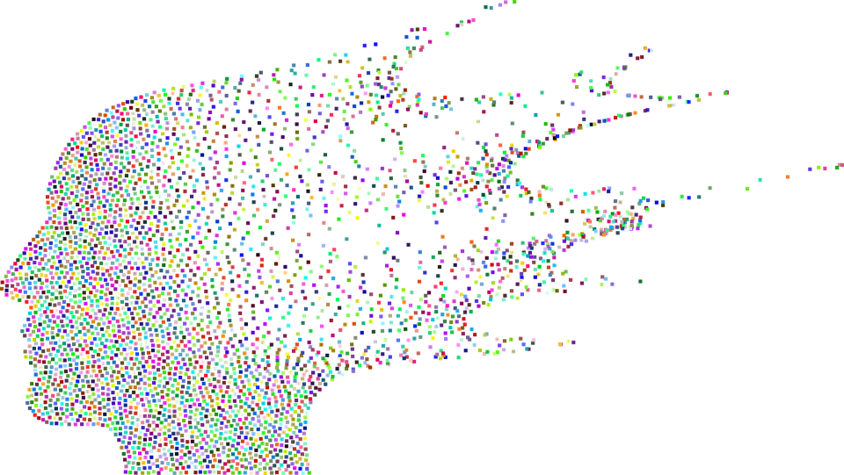
Examples of signs and symptoms of mental illness
Annex II: Additional Information on Mental Health
Feeling sad or down.
Confused thinking or reduced ability to concentrate.
Excessive fears or worries, or extreme feelings of guilt.
Extreme mood changes of highs and lows.
Withdrawal from friends and activities.
Significant tiredness, low energy or problems sleeping.
Not all of these symptoms are necessarily those of mental illness. Your doctor can help you assess and recommend treatment.
Source | Pixabay License

Slide 79
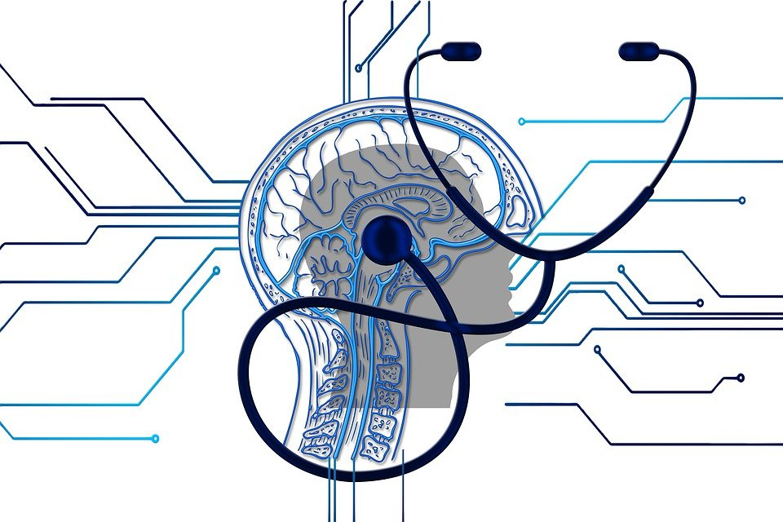
Mental illness – how to get treatment
Annex II: Additional Information on Mental Health
Don't be afraid to talk to your doctor about it.
Although some treatments may not be available, there are many ways to deal with mental health problems.
If you feel friends, family members or children need help, offer support or contact one of the local support organizations.
Source | Pixabay License

Slide 80
ANNEX III: ADDITIONAL INFORMATION ON MENTAL HEALTH RESILLIENCE

Slide 81
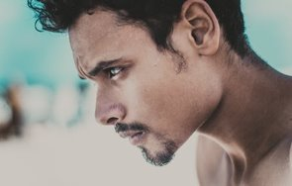
Building Mental Health Resilience
Annex III: Additional Information on Mental Health Resilience
How can I cope with challenges on a daily basis?
Resilience is the ability to recover and adapt from life’s misfortunes and troubles
Resilience gives people the emotional strength to deal with trauma, adversity and hardship
People who are resilient utilize their resources, strengths and skills to overcome challenges and work through any setbacks
Flexibility, adaptability and perseverance can help people to tap into their resilience by changing certain thoughts and behaviors
Source | Pexels license

Slide 82
Coping Strategies
Annex III: Additional Information on Mental Health Resilience
Resilient people do experience stress, setbacks and difficult emotions, but they tap into their strengths and seek help from support systems to overcome challenges and work through problems. Resilience empowers them to accept and adapt to a situation and move forward
People face different adversities and crises in life such as:
Illnesses
Loss of loved ones
Job loss
Abuse
Bullying
Financial Instability
Tragic events i.e. terrorist attacks, mass shootings, natural disasters,COVID-19

Slide 83
Steps to Building Resilience
Annex III: Additional Information on Mental Health Resilience
Coping skills..
How can I build resilience?
In order to build resilience, you will have to:
Develop self-awareness
Build self-regulation skills
Learn coping skills
Increase optimism
Strengthen connections
Know your strengths
Sleep Well
Exercise
Think Positively
Eat Healthy
Keep Things Simple
Work
Smart
Worry Less

Slide 84
https://www.youtube.com/watch?v=RMnZFXjKtAs
Annex III: Additional Information on Mental Health Resilience

Slide 85
Which of the following does not describe an adversity or challenge in life?
Only one answer is correct!
A. Abuse
B. Needs fulfillment
C. Illness
D. Job loss
Notes:
B

Slide 86
Which of the following two statements are correct?
Two answers are correct!
A. Resilience is the ability to bounce back and adapt to life’s misfortunes and set backs
B. People who are resilient avoid utilizing their resources, strengths and skills to overcome challenges and work through any setbacks
C. Flexibility, adaptability and perseverance prevent people from tapping into their resilience by changing certain thoughts and behaviors
D. Resilience gives people the emotional strength to cope with trauma, adversity and hardship

Slide 87
References and further reading (1)
Bryce, E., Mullany, L.C., Khatry, S.K. et al. 2020. Coverage of the WHO’s four essential elements of newborn care and their association with neonatal survival in southern Nepal. BMC Pregnancy Childbirth 20, 540 https://doi.org/10.1186/s12884-020-03239-6
Carr T.P et al. 2016. Advanced Nutrition and Human Metabolism. Cengage Learning.
Center for Disease Control and Prevention (CDC) n.d. https://www.cdc.gov/ncbddd/birthdefects/prevention.html
European Commission. 2020. The health benefits of vaccination. https://ec.europa.eu/commission/presscorner/detail/en/fs_20_2364.
European Parliament, Directorate General for Internal Policy. 2017. Research for CULT–Committee. Why Cultural Work with Refugees. Retrieved from: http://www.europarl.europa.eu/RegData/etudes/IDAN/2017/602004/IPOL_IDA(2017)602004_EN.pdf
European Centre for Disease Prevention and Control. 2020. Guidance on infection prevention and control of coronavirus disease (COVID-19) in migrant and refugee reception and detention centres in the EU/EEA and the United Kingdom
International Scientific Forum on Home Hygiene. 2018. Containing the burden of infectious diseases is everyone’s responsibility: A call for an integrated strategy for developing and promoting hygiene behaviour change in home and everyday life [White Paper]. https://www.ifh-homehygiene.org/sites/default/files/publications/IFH%20White%20Paper-10-18.pdf.
John Hopkins Medicine. n.d. https://www.hopkinsmedicine.org/health/treatment-tests-and-therapies/screening-tests-for-common-diseases
Johns Hopkins Medicine. n.d. - https://www.hopkinsmedicine.org/health/wellness-and-prevention/abcs-of-eating-smart-for-a-healthy-heart
John Hopkins Medicine .n.d. Malnutrition. https://www.hopkinsmedicine.org/health/conditions-and-diseases/malnutrition

Slide 88
References and further reading (2)
Matlin, S.A., Depoux, A., Schütte, S. et al. 2018. Migrants’ and refugees’ health: towards an agenda of solutions. Public Health Rev 39, 27. https://doi.org/10.1186/s40985-018-0104-9
National Institute on Alcohol Abuse and Alcoholism. 2007. - Alcohol and Tobacco https://pubs.niaaa.nih.gov/publications/aa71/aa71.htm.
NSW Refugee Health Service and STARTTS (NSW Service for the Treatment and Rehabilitation of Torture and Trauma Survivors). 2014. Working with refugees: a guide for social workers. Retrieved from: https://www.startts.org.au/media/Resource-Working-with-Refugees-Social-Worker-Guide.pdf
P.J. Shannon, E. Wieling, J.Simmelink-McCleary, E. Becher. 2014. Beyond Stigma: Barriers to Discussing Mental Health in Refugee Populations, Journal of Loss and Trauma International Perspectives on Stress & Coping, Taylor and Francis Online.
Saunders J, Smith T. 2010, Malnutrition: causes and consequences. Clin Med. 2010;10(6):624-627. doi:10.7861/clinmedicine.10-6-624
WHO. n.d. Chapter 8 - Personal, domestic and community hygiene. https://www.who.int/water_sanitation_health/hygiene/settings/hvchap8.pdf
WHO. n.d. Migration and Health: Key Issues. https://www.euro.who.int/__data/assets/pdf_file/0005/293270/Migration-Health-Key-Issues-.pdf
WHO. 2013. Vaccine Safety Basics: Learning Manual. SAFETY. https://www.who.int/vaccine_safety/initiative/tech_support/Vaccine-safety-E-course-manual.pdf
WHO. 2018. Nutrition. https://www.who.int/news-room/facts-in-pictures/detail/nutrition

Slide 89
References and further reading (3)
WHO. 2018. Report on the health of refugees and migrants in the WHO European Region: no public health without refugee and migrant health. ISBN 978 92 890 5384 6. https://www.euro.who.int/en/health-topics/health-determinants/migration-and-health/publications/2018/report-on-the-health-of-refugees-and-migrants-in-the-who-european-region-no-public-health-without-refugee-and-migrant-health-2018
WHO. 2019. https://www.who.int/news-room/facts-in-pictures/detail/immunization
WHO. 2019. Vaccines and immunizations. https://www.who.int/health-topics/vaccines-and-immunization#tab=tab_1
WHO. 2021. Vaccines and immunization: What is vaccination? https://www.who.int/news-room/questions-and-answers/item/vaccines-and-immunization-what-is-vaccination.
UNICEF. 2020. Immunization. https://www.unicef.org/eca/health/immunization.
UNHCR. 2015. Culture, Context and the Mental Health and Psychosocial Wellbeing of Syrians. A Review for Mental Health and Psychosocial Support staff Working with Syrians Affected by Armed Conflict. Retrieved from: https://www.unhcr.org/55f6b90f9.pdf
UNHCR, IOM, MHPSS. 2015. Mental Health and Psychosocial Support for Refugees, Asylum Seekers and Migrants on the Move in Europe. A multi-agency guidance note. Retrieved from: http://www.euro.who.int/en/health-topics/health-determinants/migration-and-health/publications/2016/mental-health-and-psychosocial-support-for-refugees,-asylum-seekers-and-migrants-on-the-move-in-europe.-a-multi-agency-guidance-note-2015

Slide 90
Congratulations! You have completed this module!
The European Commission support for the production of this publication does not constitute an endorsement of the contents which reflects the views only of the authors, and the Commission cannot be held responsible for any use which may be made of the information contained therein.

