Slide 1
1
2
3
4
5
Module 1 What is Digital Health Literacy and its relevance?
6
The European Commission support for the production of this publication does not constitute an endorsement of the contents which reflects the views only of the authors, and the Commission cannot be held responsible for any use which may be made of the information contained therein.

Slide 2
Partners
WESTFALISCHE HOCHSCHULE GELSENKIRCHEN, BOCHOLT, RECKLINGHAUSEN
GELSENKIRCHEN, GERMANY
www.w-hs.de
PROLIPSIS
ATHENS, GREECE www.prolepsis.gr
OXFAM ITALIA INTERCULTURA
AREZZO, ITALY
www.oxfamitalia.org/
UNIVERSITAT DE VALENCIA
VALENCIA, SPAIN
www.uv.es
COORDINA ORGANIZACIÓN DE EMPRESAS Y RECURSOS HUMANOS, S.L.
VALENCIA, SPAIN
coordina-oerh.com
media k GmbH
Bad Mergentheim, GERMANY
www.media-k.eu
AKADIMAIKO DIADIKTYO (GUnet)
ATHENS, GREECE
www.gunet.gr

Slide 3
Modules
1. What is Digital Health Literacy and its relevance
2. Main health issues when landing in a new country
3. Healthcare Services
4. Turning digitally literate
5. Exploring Digital Health tools
6. Being active in the digital health environment

Slide 4
Objectives
1
What is Digital Health Literacy and its relevance?
To introduce the training course contents
To introduce the main concepts of Digital Health Literacy

Slide 5
Competences
1
What is Digital Health Literacy and its relevance?
Knowledge about Digital Health Literacy (for migrants, migrant peers and health professionals)
Gained awareness about Digital Health Literacy’s relevance for migrant’s health (for migrant, migrant peers and health professionals)
Source | Pixabay license

Slide 6
Introduction to the training course
Objectives
You will learn about the structure and the content of the Erasmus+ programme MIG-DHL and you will get a first idea of the concept of Digital Health Literacy.

Slide 7
Action 1.1.1 Opening
1.1
1.1.1
Objectives
1.1.2
Let’s start …
You will learn about the structure and the content of the Erasmus+ programme MIG-DHL.
1.1.3
1.1.4
1.1.5

Slide 8
The Erasmus+ Programm
1.1 Opening
The following video gives a good overview about the idea of Erasmus+ Programme and especially about the idea of Erasmus+ K2-strategice partnership:
https://www.youtube.com/watch?v=ap2guv2PFco
Source | Pixabay license

Slide 9
Overview of the project- the materials
1.1 Opening
I.O.1
RESULTS FROM CO-CREATION
I.O.1
RESULTS FROM CO-CREATION
I.O.2
TRAINING
MATERIALS
I.O.3
DESIGNED PRACTICAL TRAINING ACTIVITIES
HANDBOOKS
PRESENTATIONS
GAMES & VIDEOS
TRAINING GUIDELINES FOR THE IMPLEMENTATION OF THE MODULE STRUCTURE AND ACTIVITIES
TRAINING PROGRAMME
I.O.4
ONLINE- PLATTFORM

Slide 10
Overview of the project - content
1.1 Opening
1. What is Digital Health Literacy and its relevance
2. Main health issues when landing in a new country
3. Healthcare Services
4. Turning digitally literate
5. Exploring Digital Health tools
6. Being active in the digital health environment

Slide 11
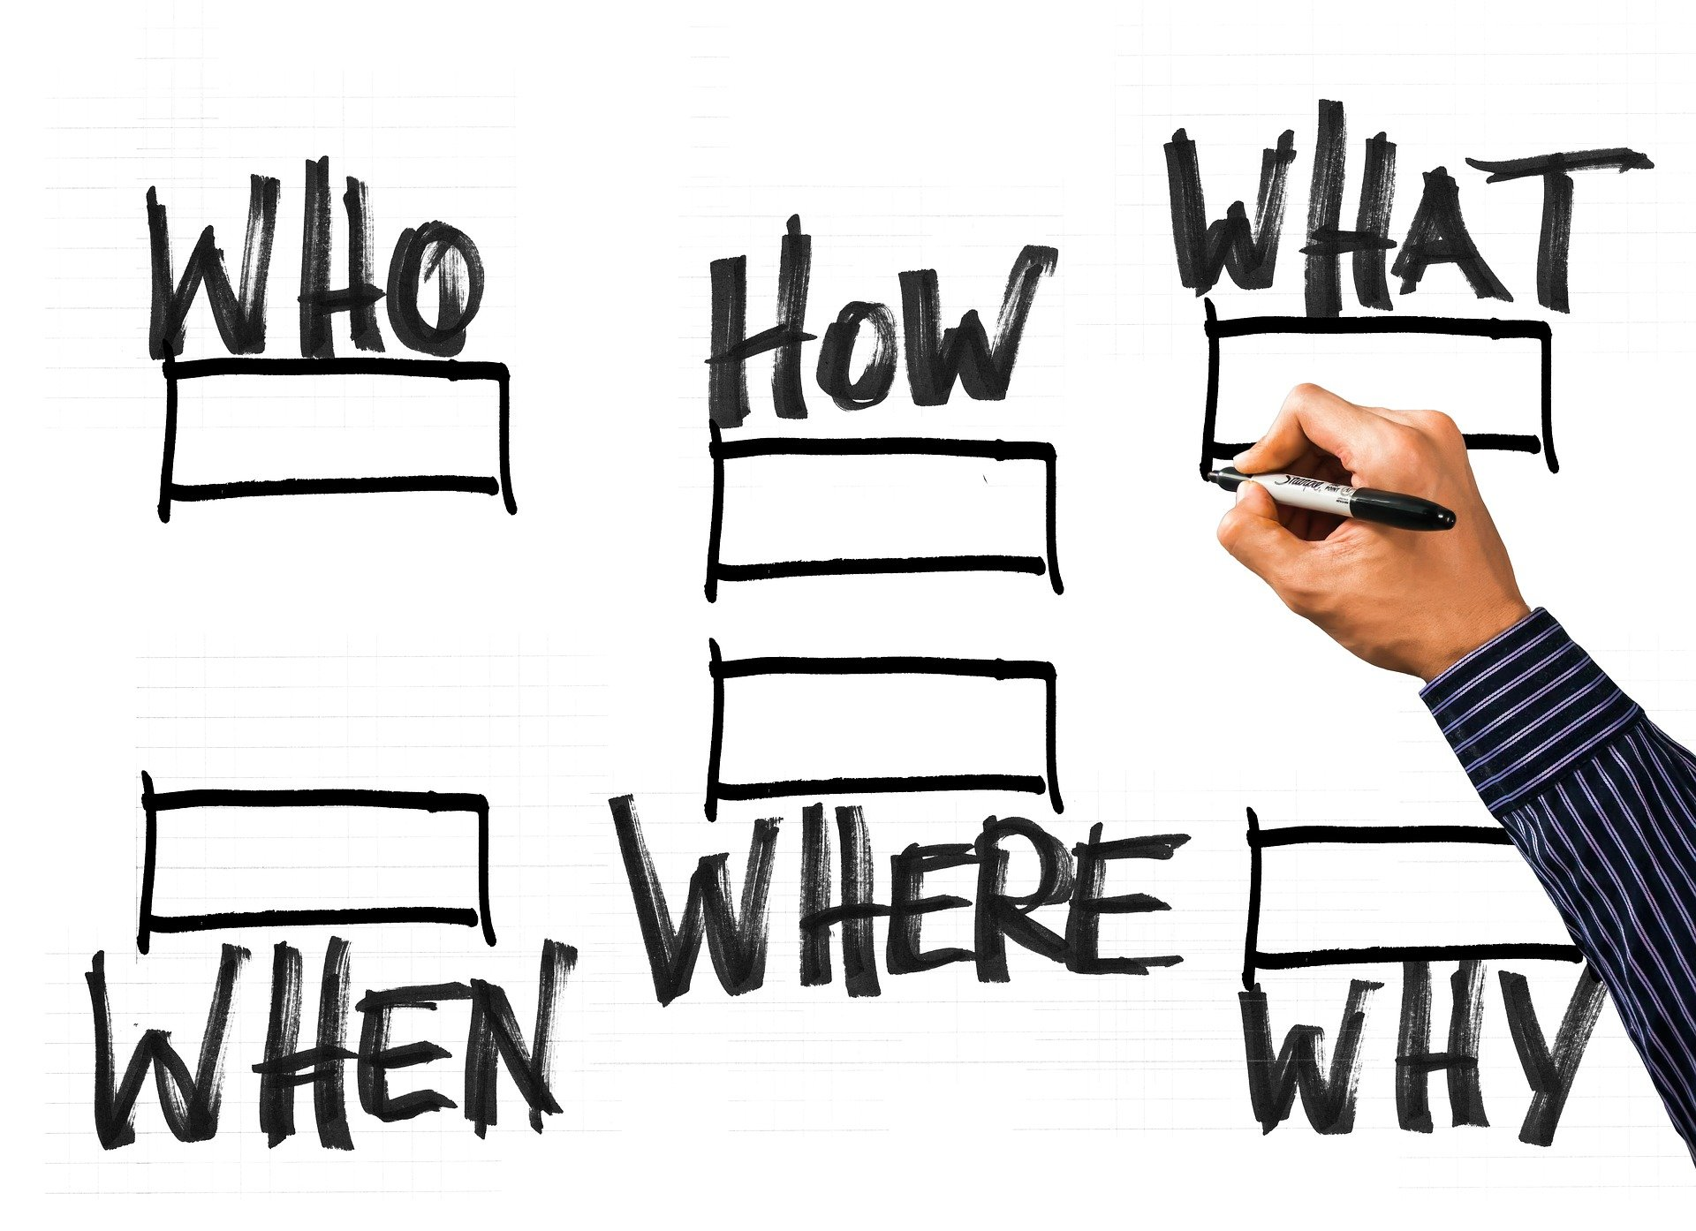
Overview of the project- organizational structure of the modules
1.1 Opening
Each module has a duration between 4.5 hours (shortest module) and 9 (longest module)
Each module consists of face-2-face sessions and online sessions.
The face-2-face sessions consists of short presentation, group-dynamic activities and practical activities.
Online sessions are individual tasks which can be done detached from the place and time of the face-2-face sessions.
Source | Pixabay license

Slide 12
Presenting Ourselves
1.1 Opening
What is my name
Which country I come from
Why I came to this country
What are my hobbies
What are my motivations and goals for this course?
Source | Pixabay license

Slide 13
Action 1.1.2 Group Dynamic - Concept of Digital Health Literacy
1.1
1.1.1
Objectives
1.2
1.1.2
You will learn about the concept of the Digital Health Literacy and the skills needed:
Operational skills
Navigation skills
Information searching
Evaluating reliability, determining relevance
Adding content
Protecting privacy.
1.1.3
1.1.4
1.1.5
Source | Pixabay license

Slide 14
The Concept of Digital Health Literacy
1.2 The concept of DHL
Digital Health Literacy (DHL)
is the ability to seek, find, understand, and appraise health information from electronic sources and apply the knowledge gained to addressing or solving a health problem.
Source | Pixabay license

Slide 15
Operational skills
1.2 The concept of DHL
How easy or difficult is it for you:
to use your computer and web browser?
to show/teach this to others/to guide someone else to do so?
Source | Pixabay license

Slide 16
Navigation skills
1.2 The concept of DHL
How easy or difficult is it for you to find your way around the internet?
Source | Pixabay license

Slide 17
Information searching
1.2 The concept of DHL
How easy or difficult is it for you to find information on the internet? (Related to health issues, specific diseases, etc.)
Would you say you know how to look for information on the internet?
Source | Pixabay license
Source | Pixabay license

Slide 18
Evaluating reliability
1.2 The concept of DHL
When you search for health information on the Internet, do you find it easy or difficult to decide whether the information is reliable or not?
Source | Pixabay license

Slide 19
Determining relevance
1.2 The concept of DHL
When you search for health information on the Internet, do you find it easy or difficult to choose between all the information you find?
Source | Pixabay license

Slide 20
Adding content
1.2 The concept of DHL
Have you ever…
posted a medical review?
Posted a message on a peer support forum or social networking website?
Source | Pixabay license

Slide 21
Protecting Privacy
1.2 The concept of DHL
Have you ever…
Shared personal health information (yours, or others) with others on the internet?
Accessed your own electronic health record?
Source | Pixabay license

Slide 22
Action 1.1.3 Group Dynamic – Practical Example
1.1
1.1.1
Objectives
1.2
1.1.2
You will be introduced an examble on Symptoms: Fever and dry cough:
Do I have COVID? Where do I look for information?
What should I do if I have COVID?
How do I look for information on the internet?
On which website do I look for the information?
How do I find out the next steps?
1.1.3
1.1.4
1.1.5
Source | Pixabay license

Slide 23
Action 1.1.4 Survey on previous knowledge
1.1
1.1.1
Objectives
1.2
1.1.2
You will complete a questionnaire for gathering information about your DHL skills.
1.1.3
1.1.4
1.1.5
Source | Pixabay license

Slide 24
1.4 Survey Administration
IT’S SURVEY TIME!

Slide 25
Action 1.1.5 Closing - debriefing
1.1
1.1.1
Objectives
1.2
1.1.2
You will be provided with a summary and explanations of the activities you have to carry out, outside the classroom.
1.1.3
1.1.4
1.1.5

Slide 26
1.5 Summary & Activities
Summary
Explanations on the activities

Slide 27
Action 1.2.1 Opening – Introduction to the session
1.1
1.2.1
Objectives
1.2
1.2.2
You will be informed about: what are we going to do today?
Pooling of the homework
How to manage one’s own health
1.2.3
1.2.4
1.2.5
Source | Pixabay license

Slide 28
Action 1.2.2 Pooling of the homework
1.1
1.2.1
Objectives
1.2
1.2.2
You will discuss about the reflections made during the week about:
the contents of the training
health self-assessment
1.2.3
1.2.4
Source | Pixabay license

Slide 29
Group Dynamic - Pooling of the homework
What did you find most important in the previous session?
Which is the most important DHL dimension to you?
Which are the most relevant/problematic health issues for you?
Source | Pixabay license

Slide 30
Action 1.2.3 How to manage one’s own health
1.1
1.2.1
Objectives
1.2
1.2.2
You will learn how to manage your health by following examples of other people.
1.2.3
1.2.4
Source | Pixabay license

Slide 31
Example 1
I need to make an appointment online so that my doctor can see me. I am going to go to my health centre's website to look for my doctor's name on the list of health professionals.
Source | Pixabay license

Slide 32
Example 2
I want to make an appointment with my doctor online but my health centre does not have its own website. I can't make an appointment with my doctor so that he/she can see me at the clinic. The search engine can't find what I'm looking for, only "Conselleria de Sanitat" appears in the results. I'm going to look on the internet for the nearest health centre to go and ask if I can see a doctor.
Source | Pixabay license

Slide 33
Example 3
My head hurts a lot. I'm going to look on the internet to find out why the pain might be and what pill I should take. I am sure I will find a lot of professional information. I find many forums where people share their experiences of illnesses and treatments they have taken. There is one person who says she took "Diazepam" for 20 days and it went very well. I think I will do the same. I'm sure the pain will go away and I will be able to continue my active activities as usual.
Source | Pixabay license

Slide 34
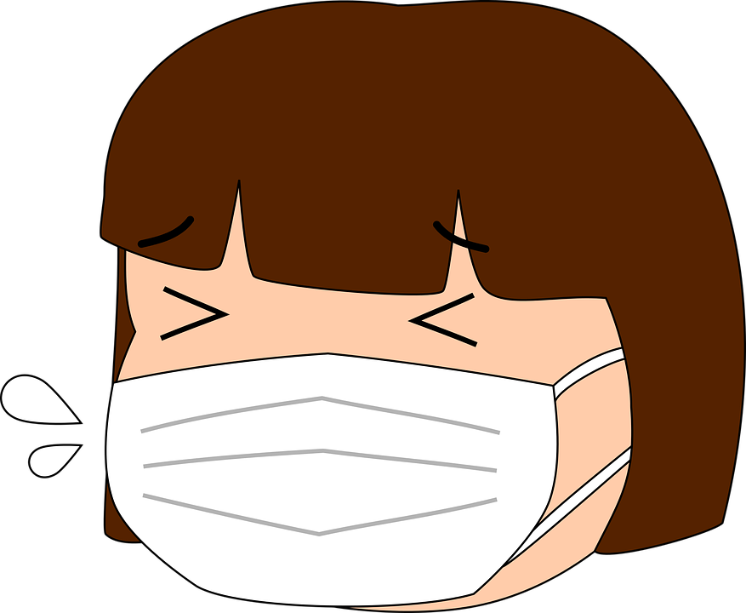
Example 4
My daughter woke up today with a little cough and sore throat but no fever. I'm taking her to the hospital near my home right now so that a doctor can take care of her.
Source | Pixabay license

Slide 35
Action 1.2.4 Closing - debriefing
1.1
1.2.1
Objectives
1.2
1.2.2
You will be provided with a summary and clarifications on possible doubts and questions.
1.2.3
1.2.4
Source | Pixabay license

Slide 36
Summary
Clarifications

Slide 37
Congratulations! You have completed this module!
The European Commission support for the production of this publication does not constitute an endorsement of the contents which reflects the views only of the authors, and the Commission cannot be held responsible for any use which may be made of the information contained therein.

